Slide 1
introduction.
Week 1 | Lecture 1 (1.1)

Slide 2
This Week’s Content
Lecture 1.1
Introduction
Lecture 1.2
Computers, Programs, and The Coding Toolbox
Lecture 1.3
Variables, Expressions, and Operators

Slide 3
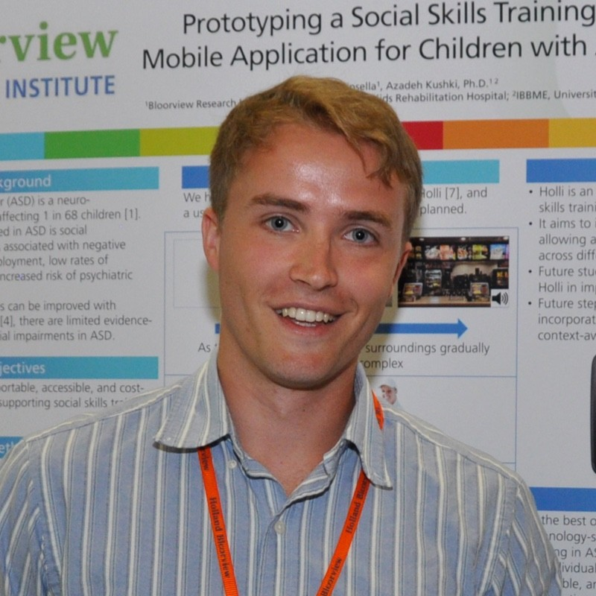


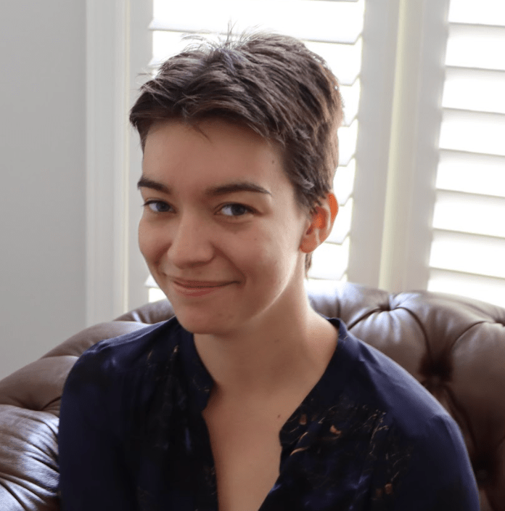

Teaching Team
Ben
Instructor
Seb
Instructor
Joseph
TA
Katia
TA
Sina
TA

Slide 4
Ben
Bachelor of Electrical & Biomedical Engineering @ McMaster University 2015
Realized the power of programming (and how it can be used for good, not evil)
Master of Biomedical Engineering @ University of Toronto 2020
Hold up… people will pay me for ‘playing’ on my computer?
In between obtaining degrees I spent time programming a few different projects…

Slide 5
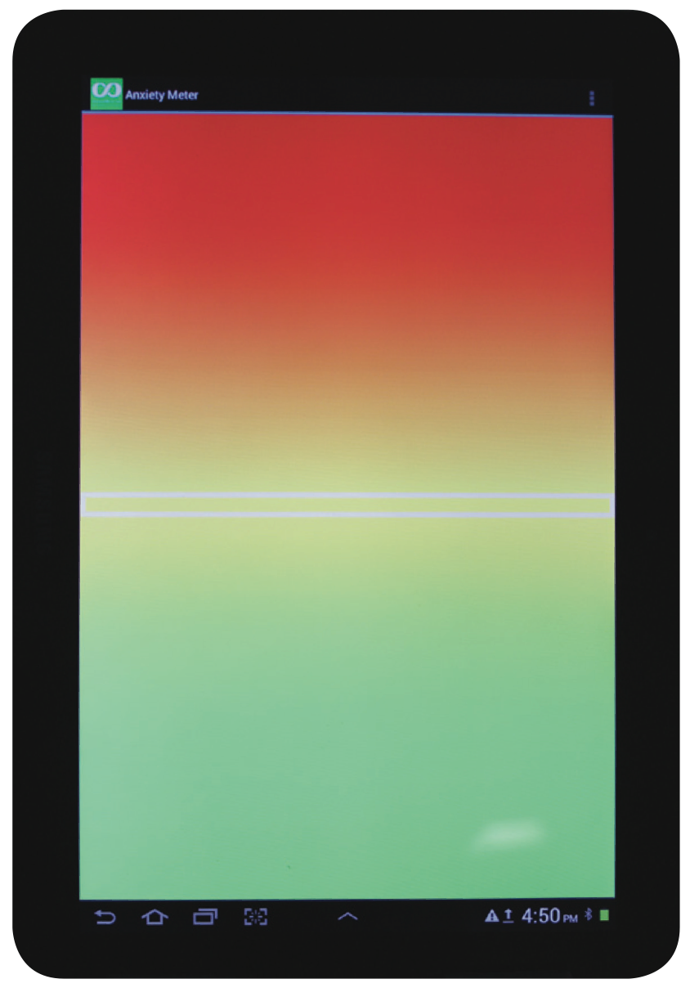


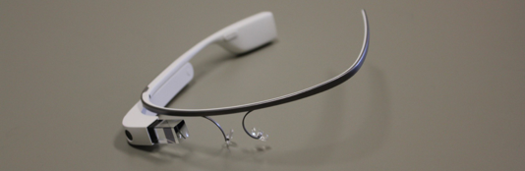

Projects for children with autism spectrum disorder
Hi!

Slide 6
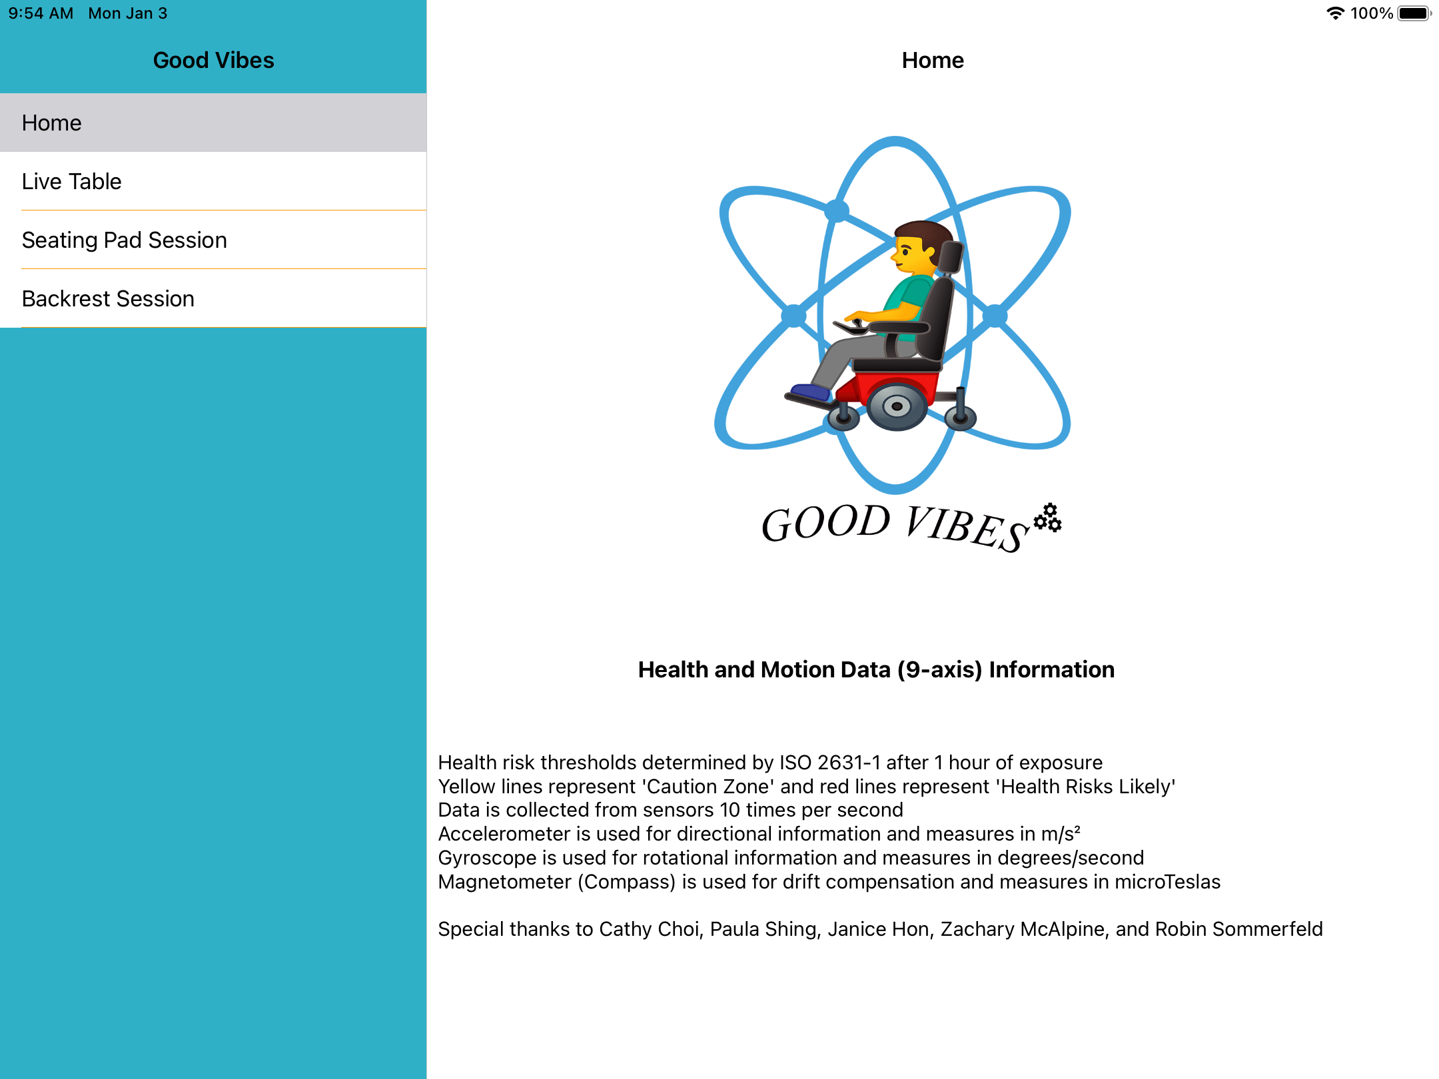
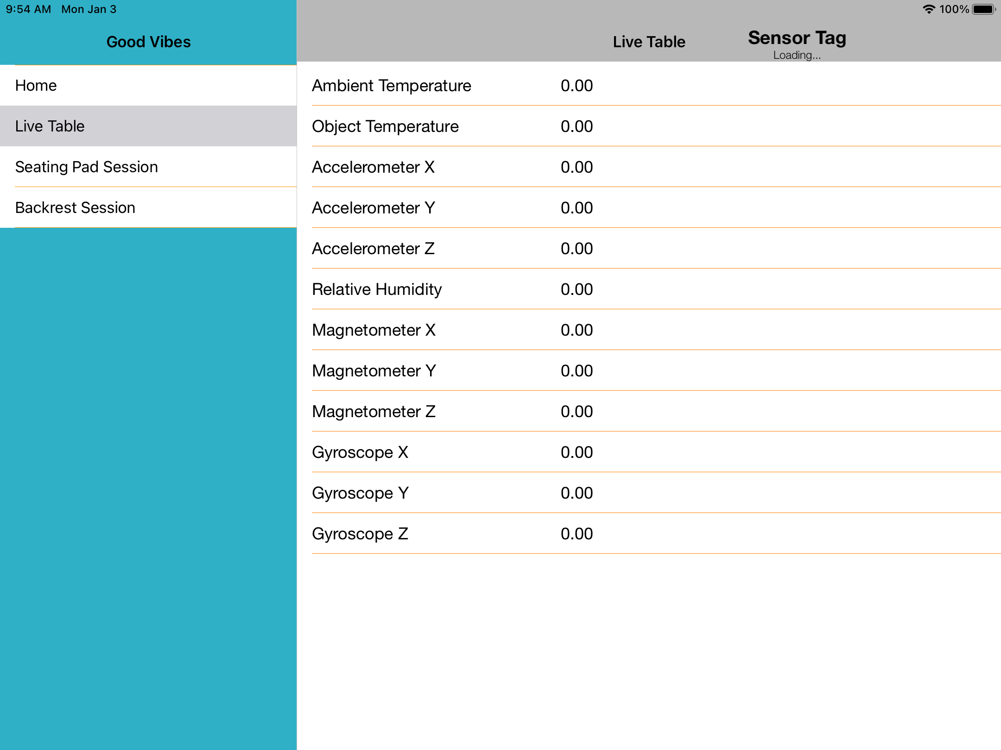
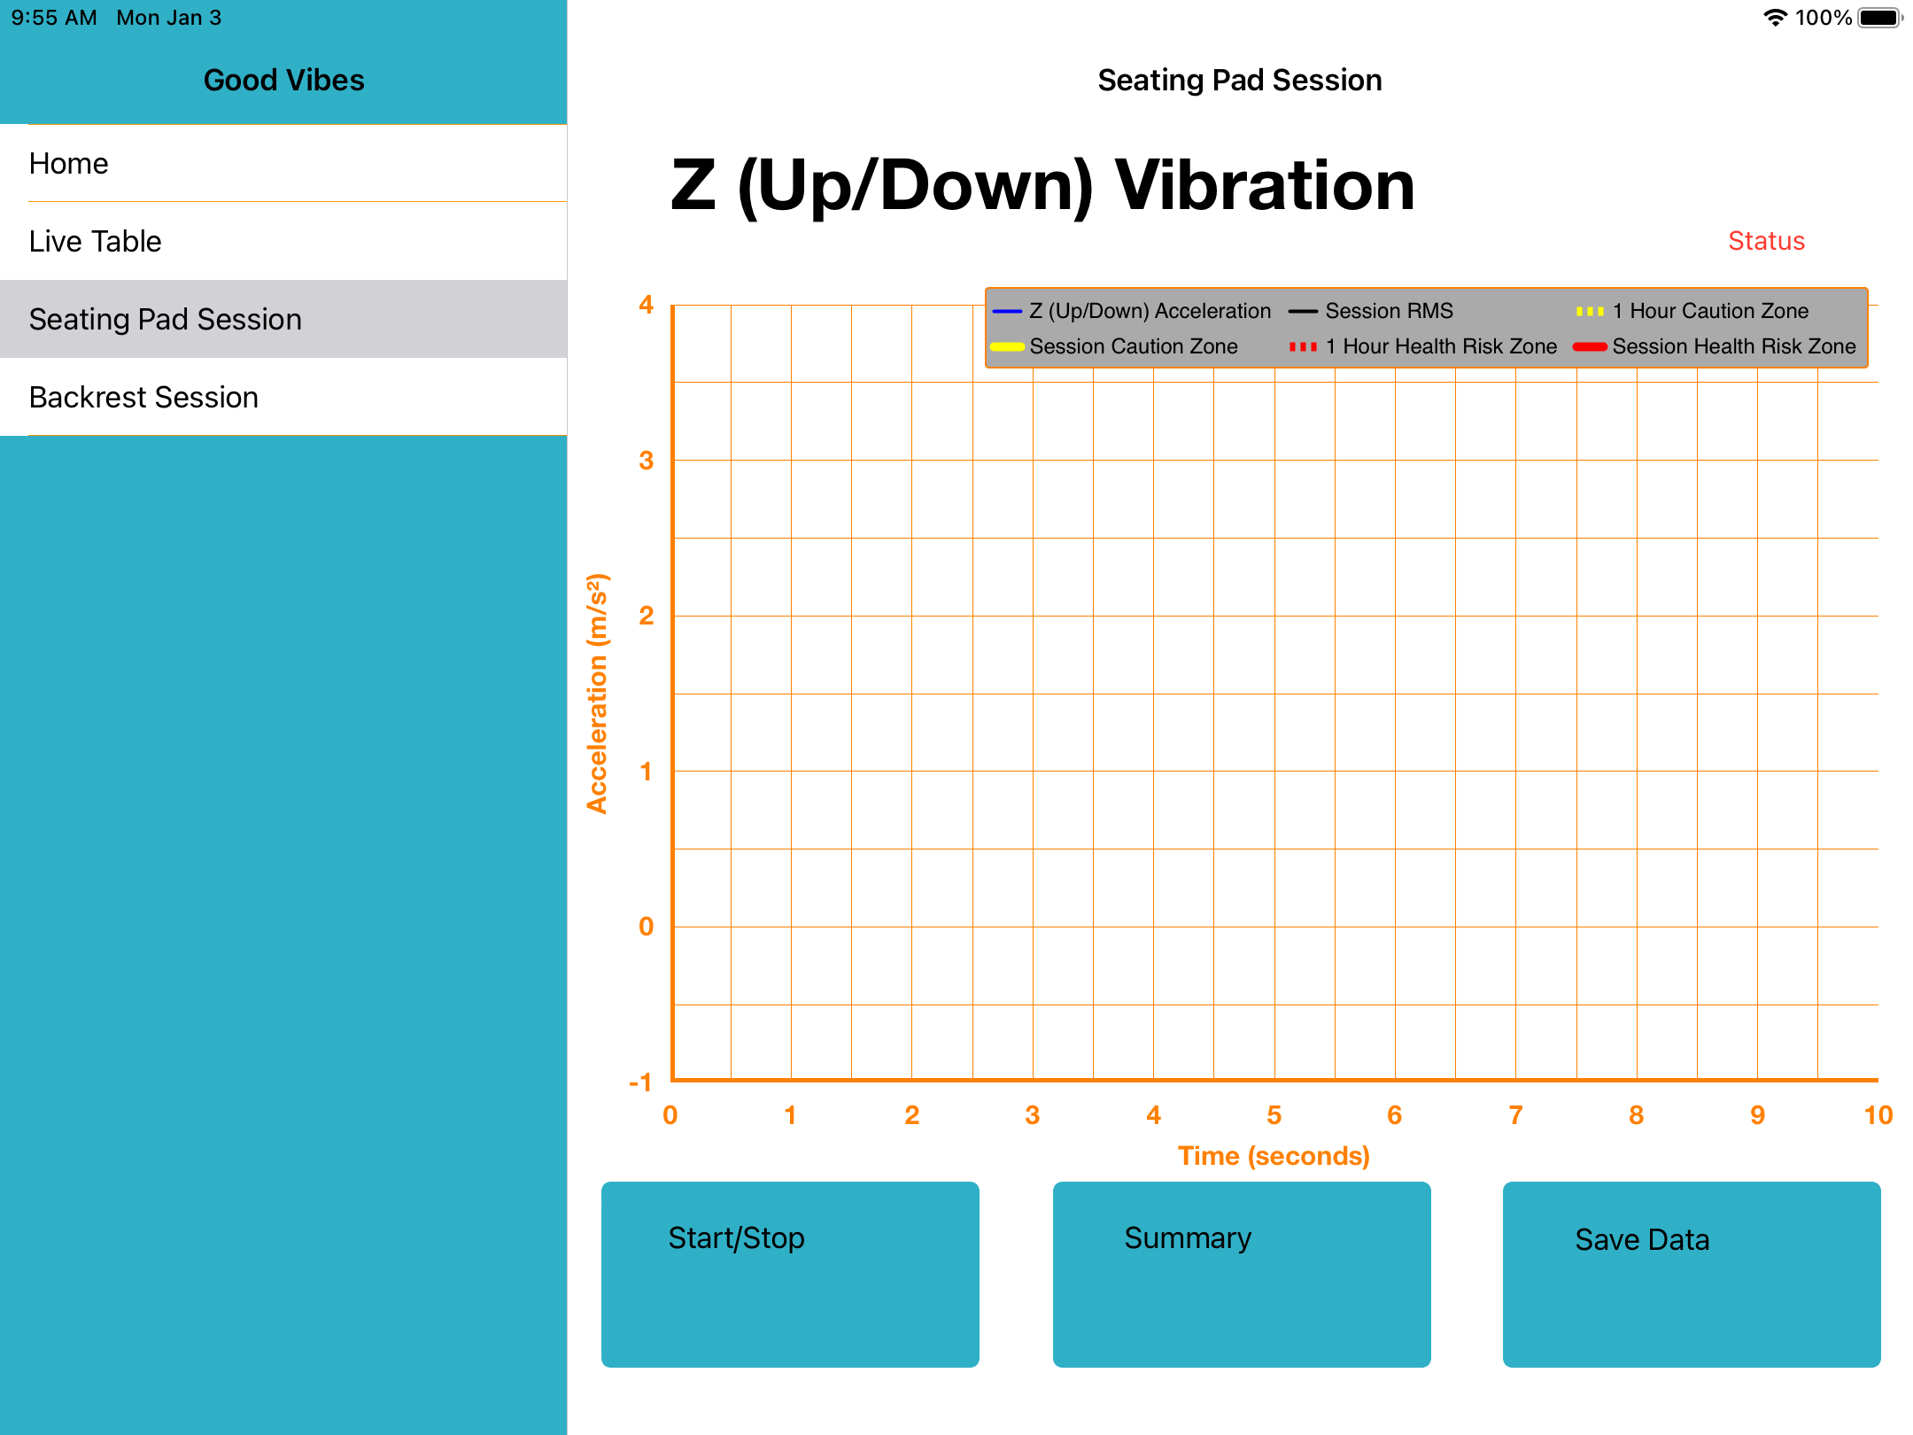
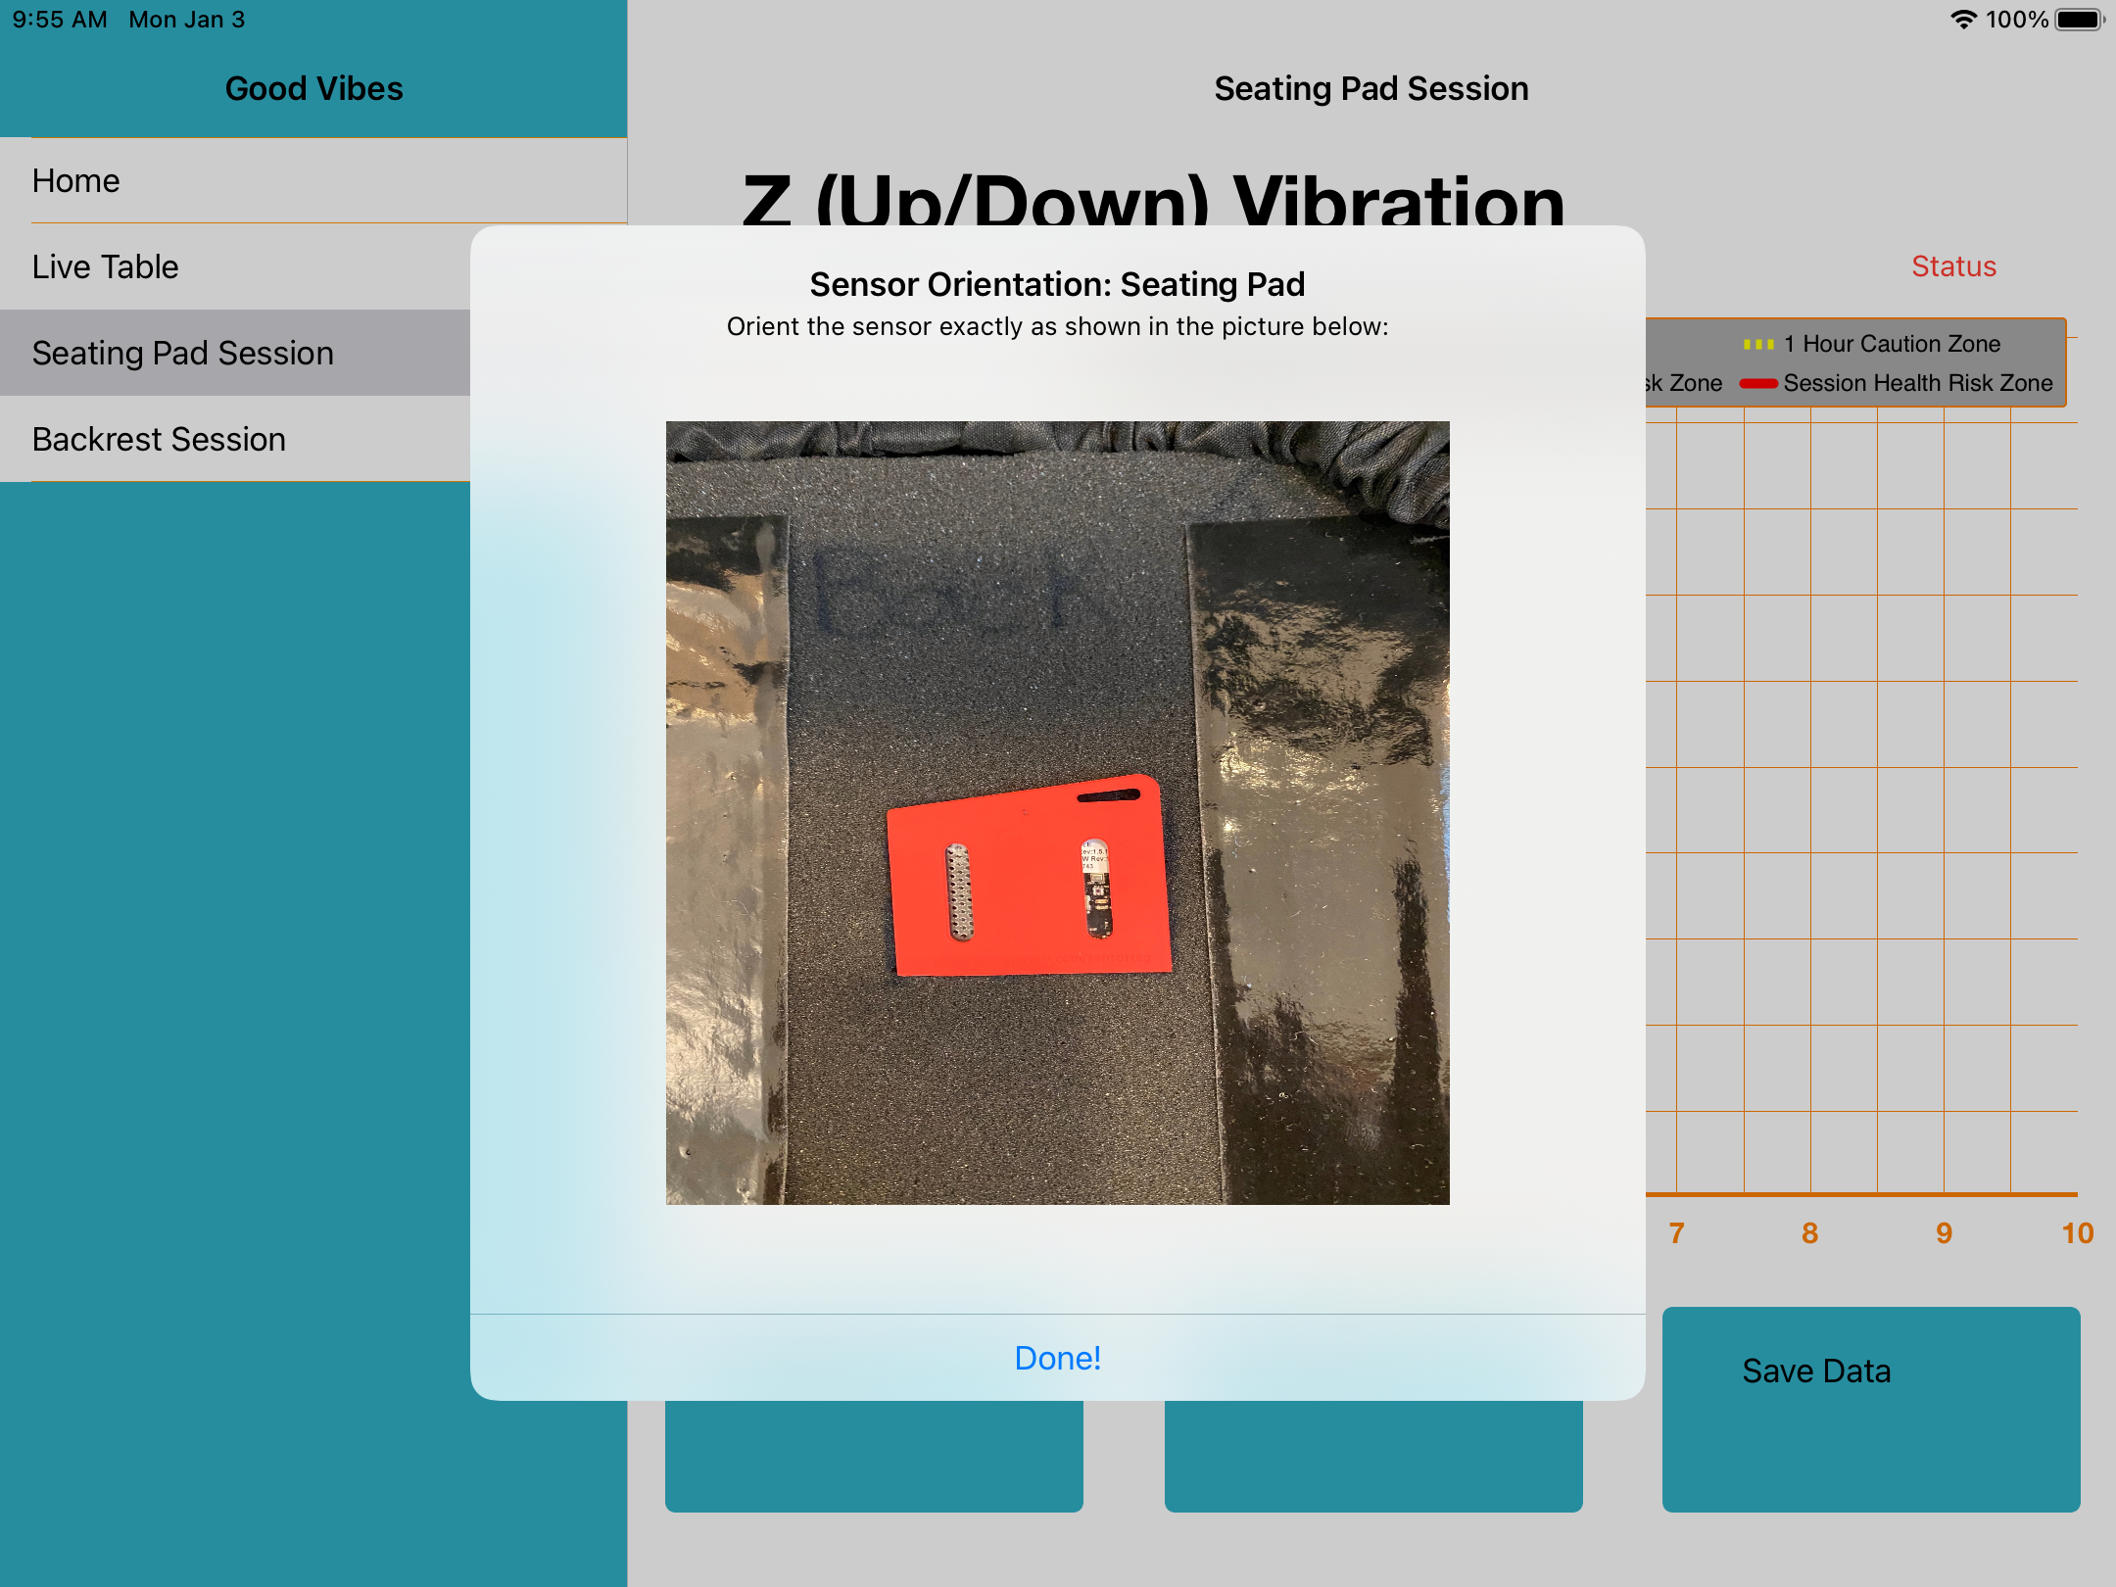


Good Vibes A wheelchair vibration measurement tool

Slide 7
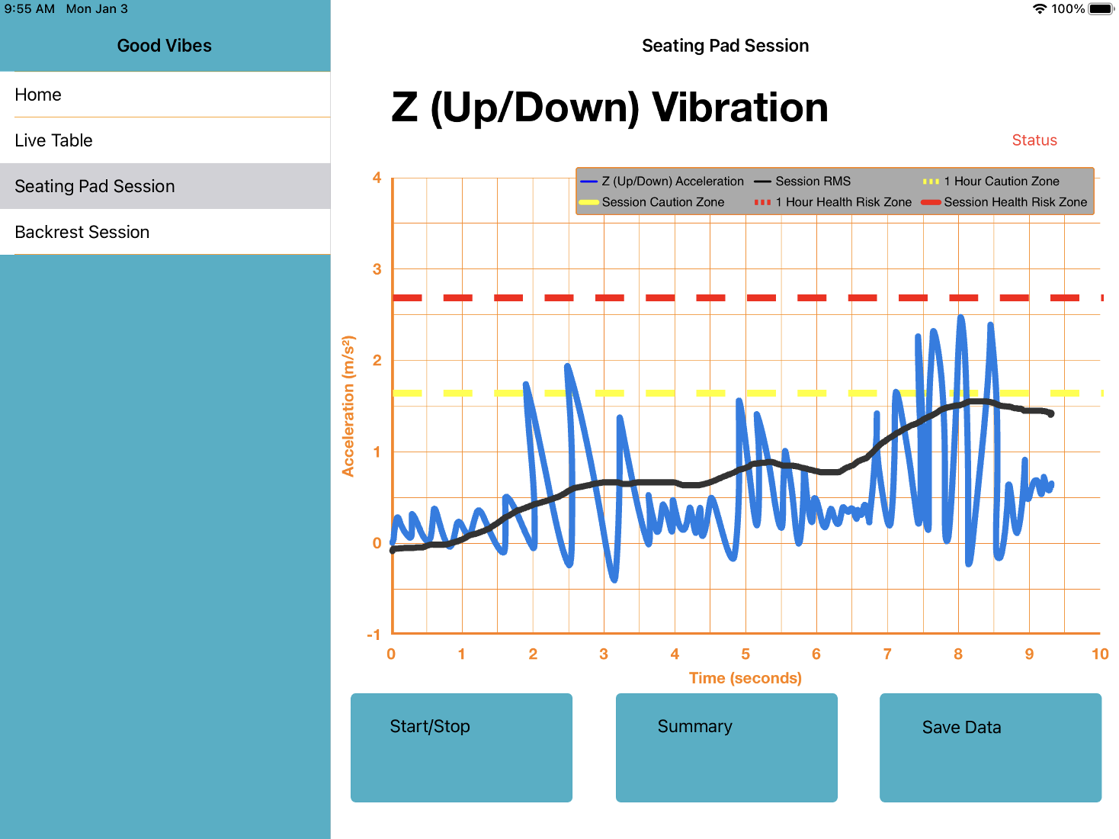

Slide 8

More about Ben…

Slide 9



Seb
Completed CivMin PhD in 2014 where I studies rock fracture and seismology (RFDF).
Senior Director of Product & AI at KORE Geosystems, a mining tech startup.
Senior Research Scientist at SickKids.
Joined UofT CivMin in January 2020.
Research topics: rock mechanics, ultrasonics, signal processing, computer vision, applied machine learning in mining.

Slide 10
Seb
Completed CivMin PhD in 2014 where I studies rock fracture and seismology (RFDF).
Senior Director of Product & AI at KORE Geosystems, a mining tech startup.
Senior Research Scientist at SickKids.
Joined UofT CivMin in January 2020.
Research topics: rock mechanics, ultrasonics, signal processing, computer vision, applied machine learning in mining.

Slide 11
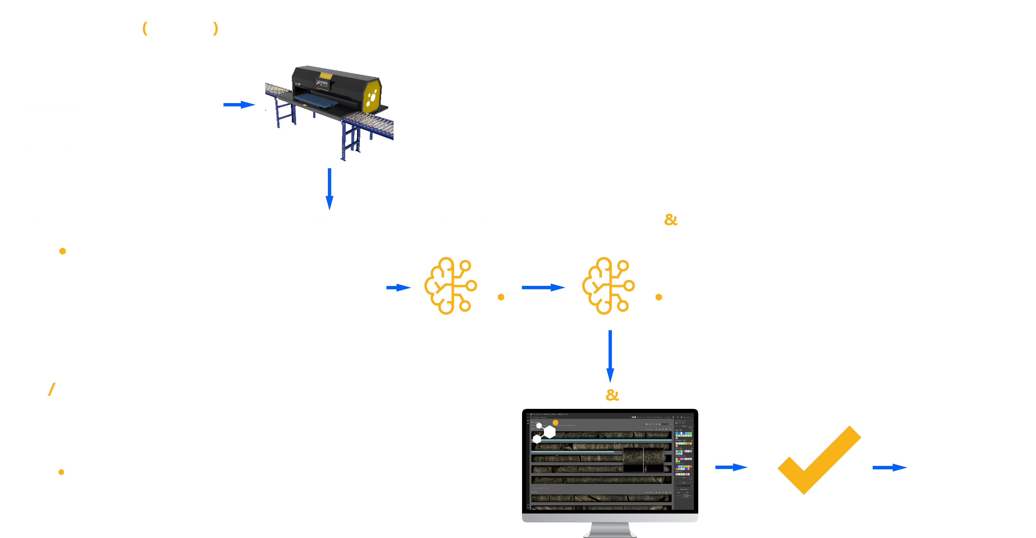
Building Tech in Mining

Slide 12
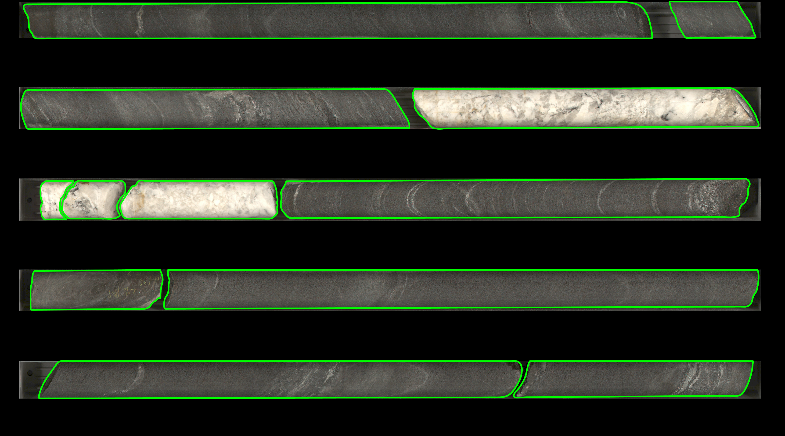
Building Tech in Mining

Slide 13
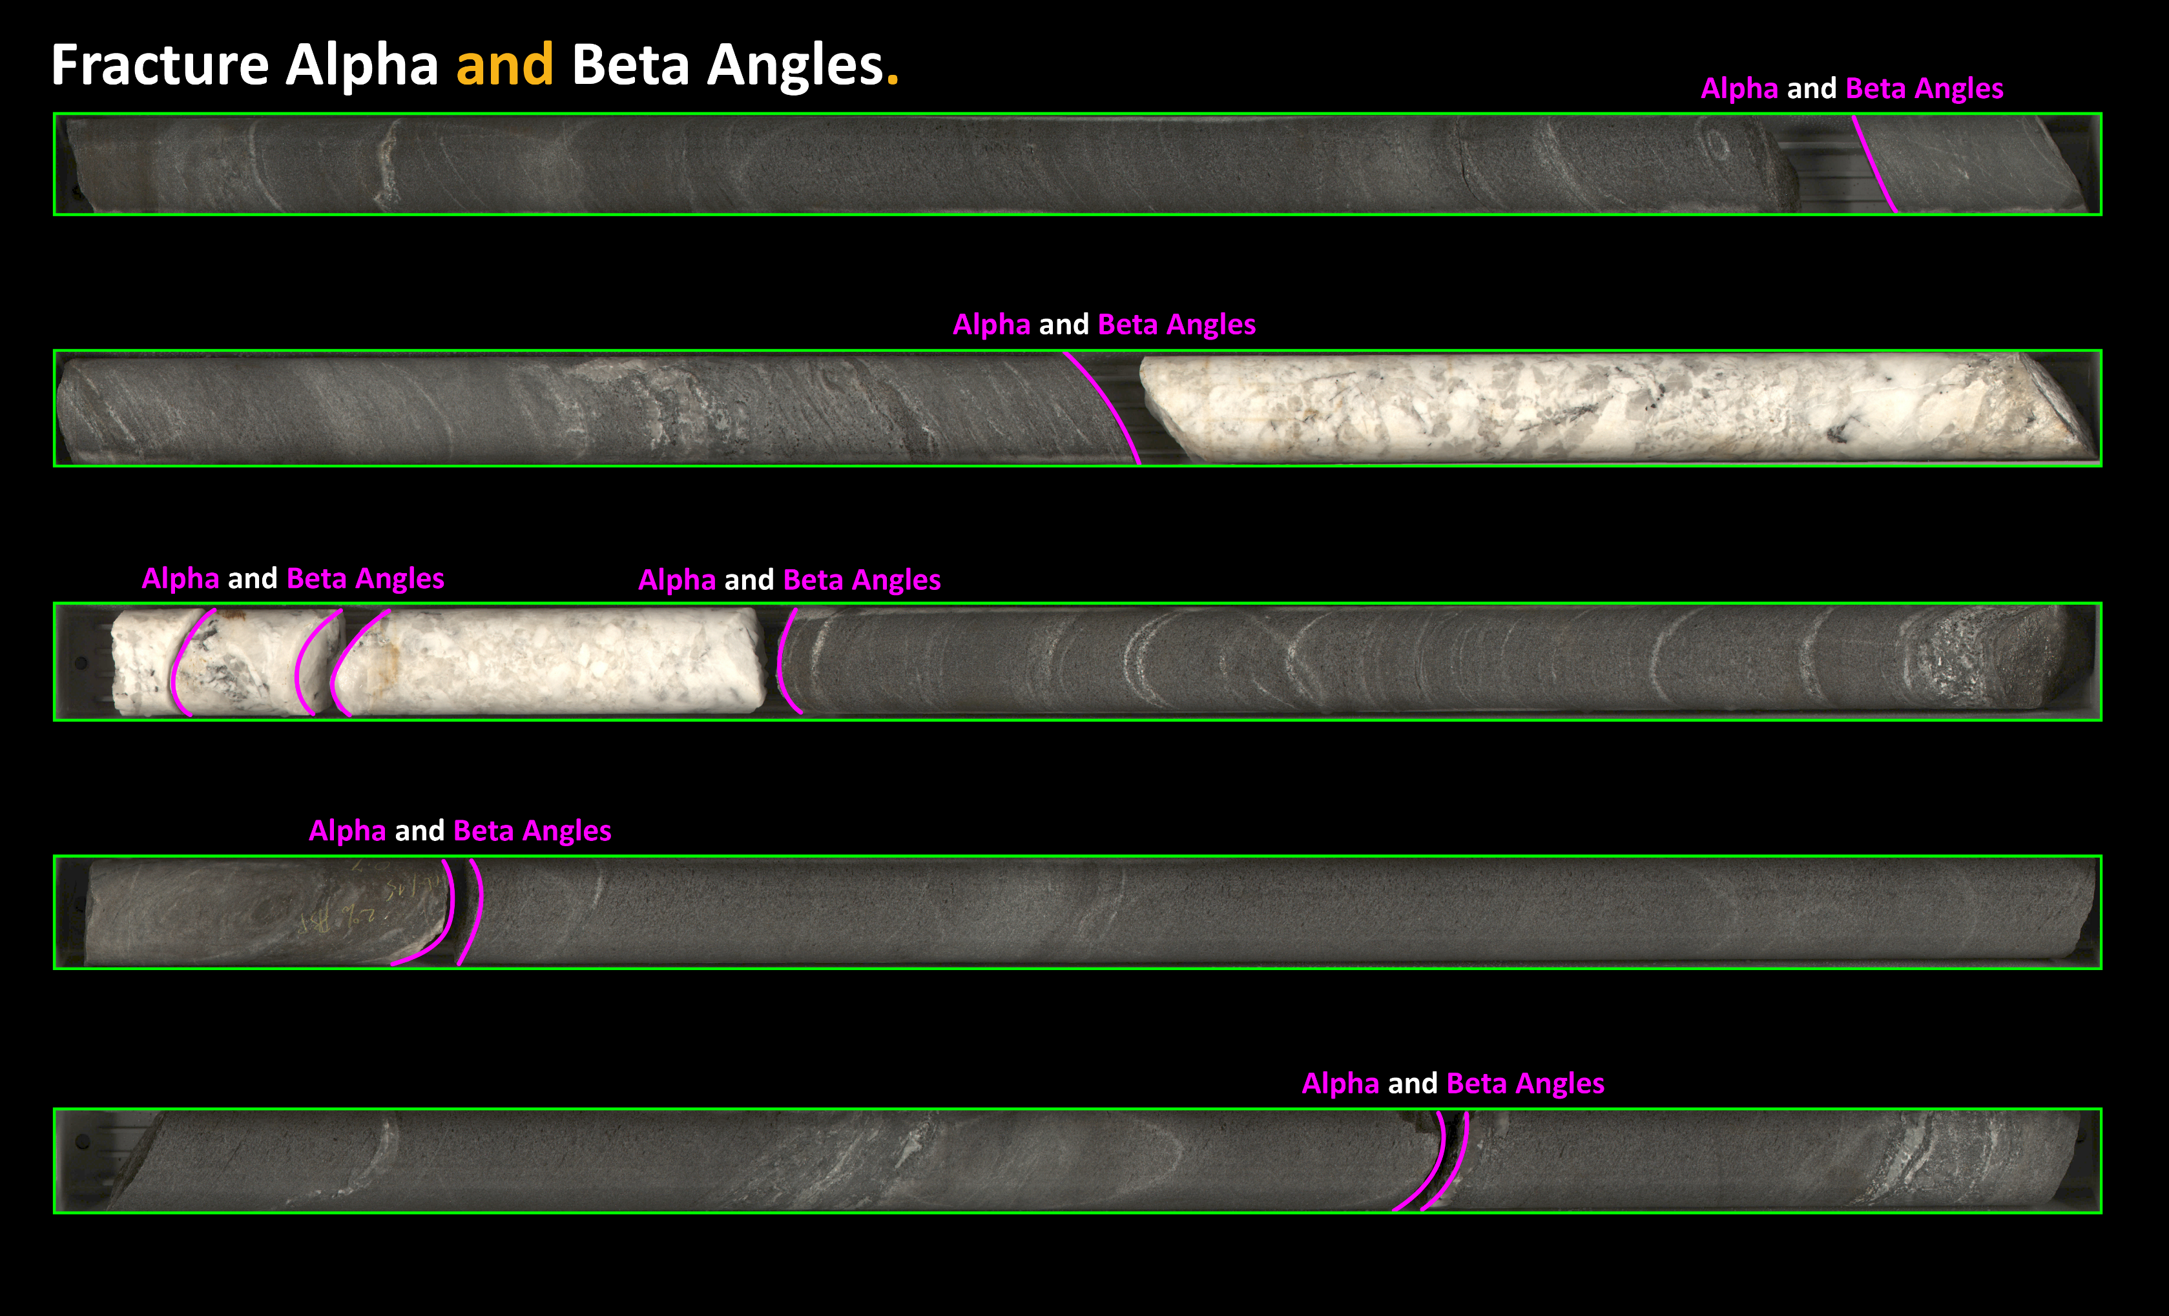
Applications in Civ & Min

Slide 14
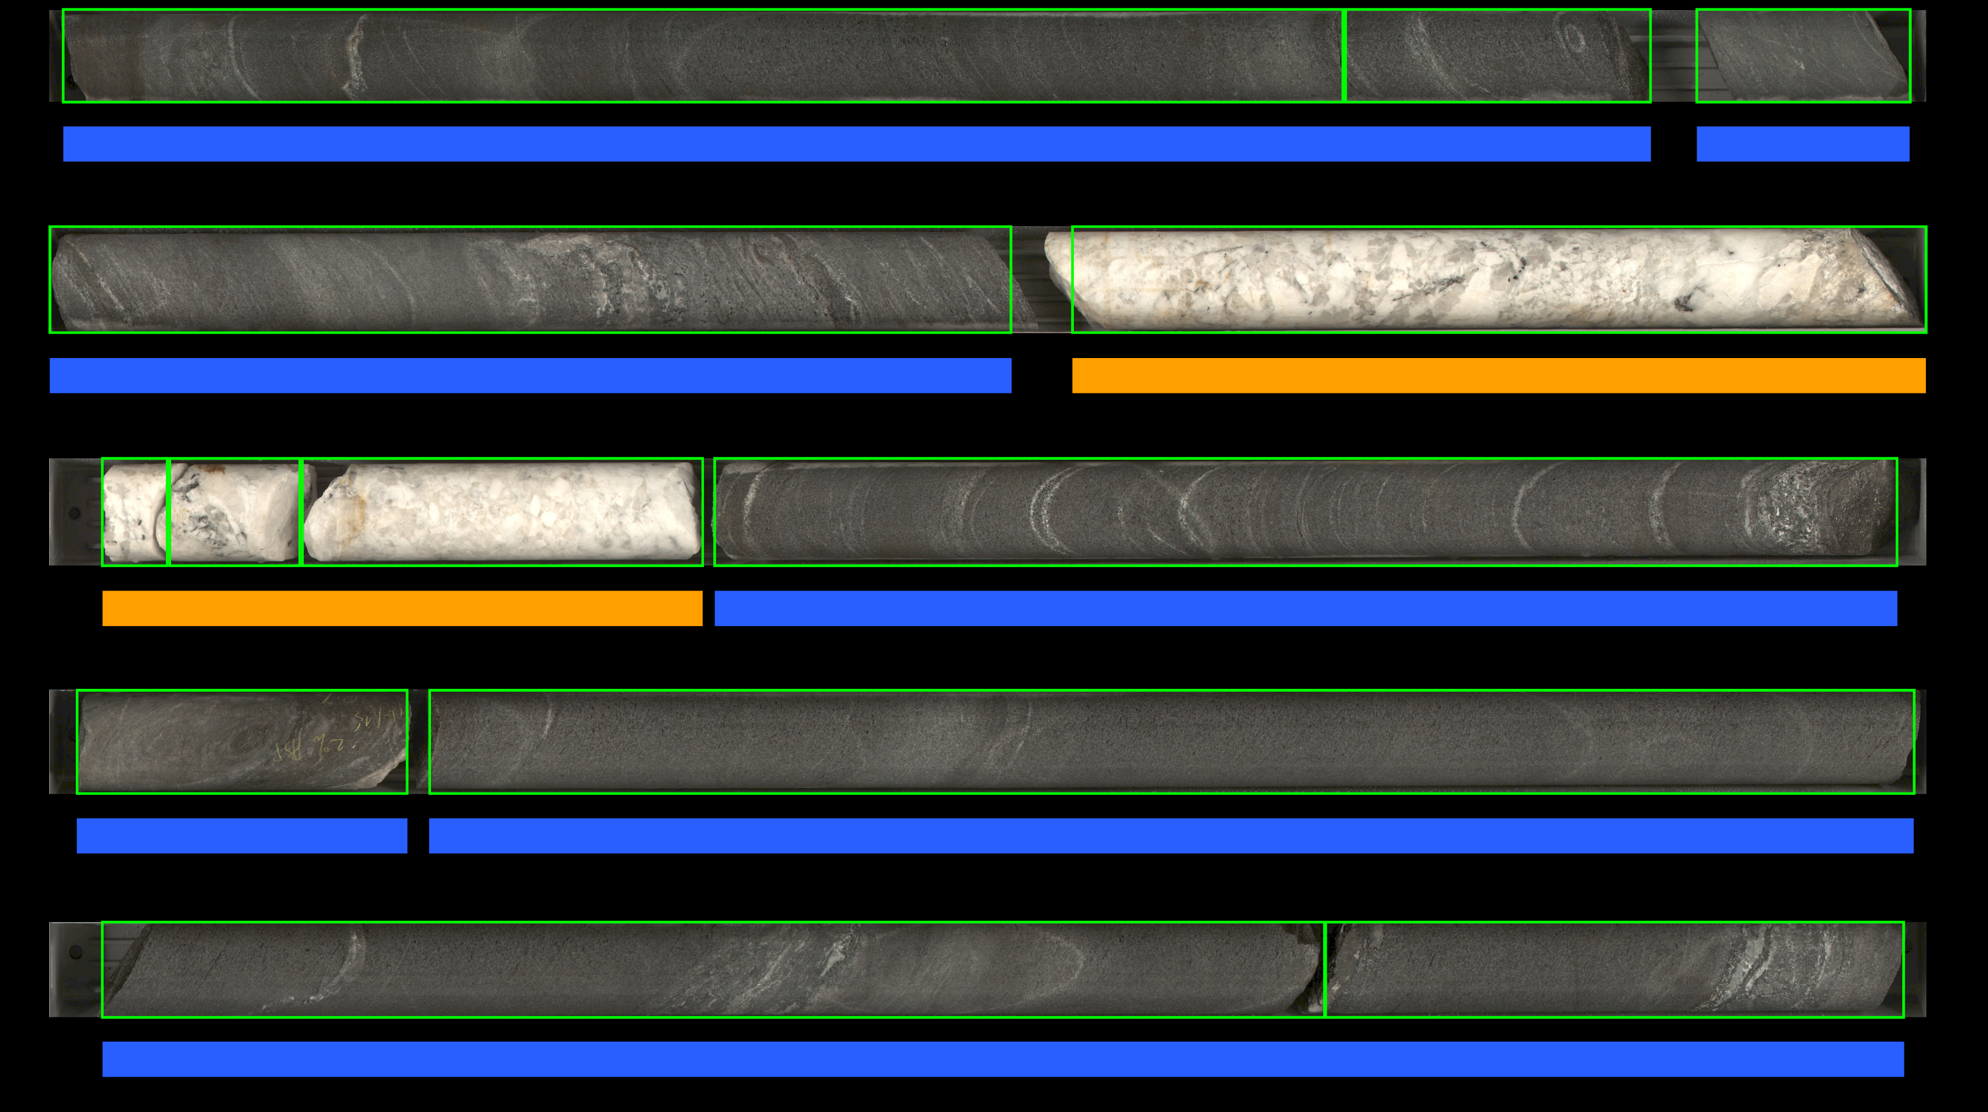
Building Tech in Mining

Slide 15
Seb
Completed CivMin PhD in 2014 where I studies rock fracture and seismology (RFDF).
Senior Director of Product & AI at KORE Geosystems, a mining tech startup.
Senior Research Scientist at SickKids.
Joined UofT CivMin in January 2020.
Research topics: rock mechanics, ultrasonics, signal processing, computer vision, applied machine learning in mining.

Slide 16


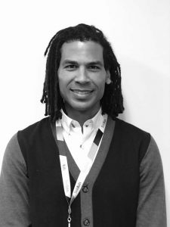



AI assistance in healthcare.
AI Diagnosis
JET 98%
AI
Detects
JET
Pages
Mjaye
Staff Physician
Nurse
Confirm
12-Lead
JET
Onset
5 minutes later
Treatment begins
AI
Notes:
Video Start: 16:02
JET Starts at 13:97

Slide 17

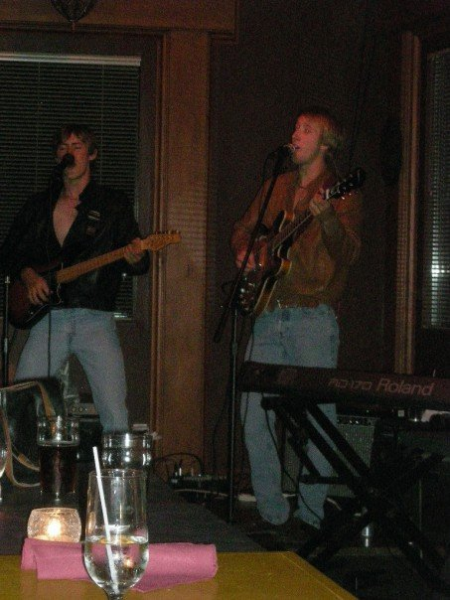
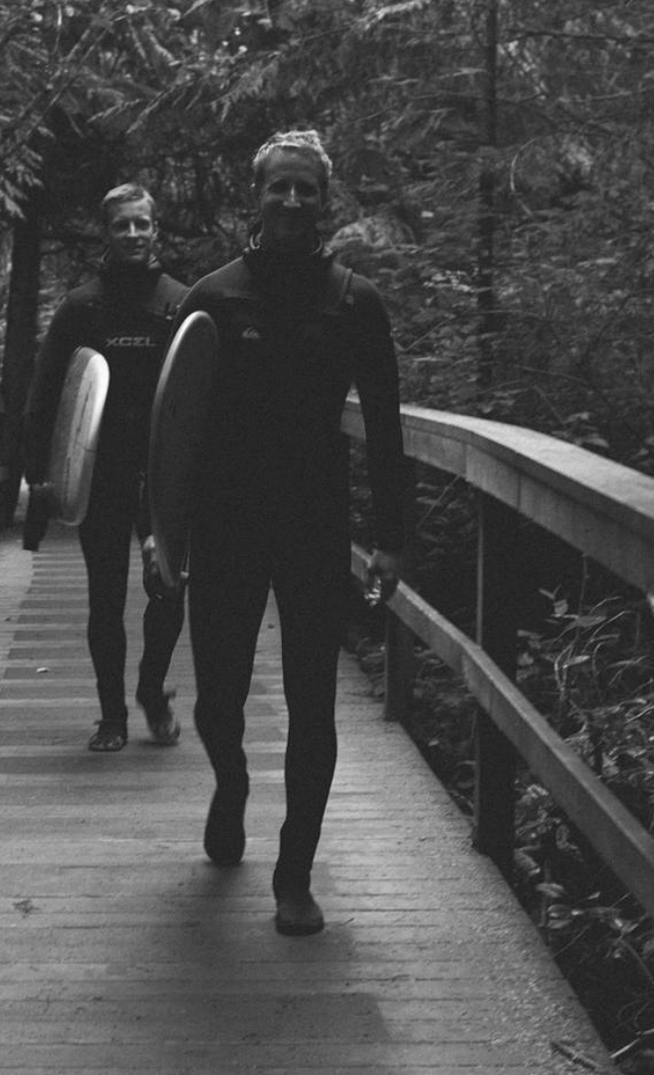



I like doing other things
I love travelling and have visited over 20 countries including France, Switzerland, Italy, Austria, Croatia, Costa Rica, Nicaragua, Panama, Peru, Bolivia, United States, Egypt, Turkey, Morocco, South Africa, and Namibia.
I was a founding member of Ottawa’s premiere Beatles cover band.
I love camping, hiking, and surfing.
I have a wonderful baby boy named Avery Goodfellow and baby girl name August.
I love building things with code ( Seb-Good).

Slide 18
Joseph
Doing a PhD in biomedical engineering.
A marathon runner and currently training for a triathlon.
Interweaves Python and MATLAB to analyze ultrasound wave propagation in artificial hearts made from stem cells through image and signal analysis.

Slide 19
Katia
Doing a Master's in Civil Engineering.​
Worked as a software application engineer-in-training (EIT) for 3.5 years.​
Working with Python to analyze and clean data!
Using Python to work with images from digital and optical microscopes of concrete and other building materials. As well, analyzing fracture behavior from Finite Discrete Element simulation models (FDEM).​
Martial arts fanatic :) involved in both Muay Thai and karate. ​
Also play piano, working towards Royal Conservatory certification.

Slide 20

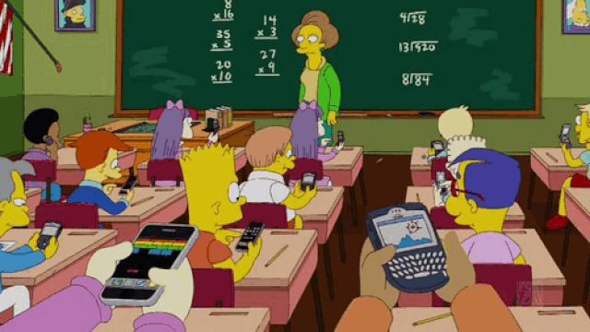
In Person
Talking
Working on other courses
Eating
Being Late for Lectures

Slide 21


In Person
Talking
Working on other courses
Eating
Being Late for Lectures

Slide 22

Ask questions!
Ask questions as much as possible.
Ask each other questions and help if you think you know the answer
Never forget - if you have a question, there’s always other people in the room wondering the same thing. They will be happy you asked it!

Slide 23
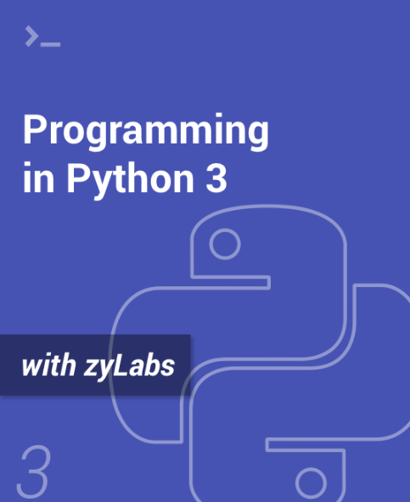
Course Information
Quercus:
APS106H1 S LEC0101 (Website contains all information).
Textbook:
Programming in Python 3.
A link to the UofT bookstore where you can purchase the textbook can be found on the Syllabus page.
Piazza:
piazza.com/utoronto.ca/winter2019/aps106

Slide 24
Grading
Petitions: First-year Office.
Reflections (13 in total)
Labs (10 in total)
Term Test 1 (Feb 6)
Term Test 2 (March 21)
Final Exam
total: 2%
total: 10%
total: 15%
total: 23%
total: 50%

Slide 25
Lecture Schedule
Section | Monday | Tuesday | Wednesday | Thursday | Friday
LEC0101 |  | 4:00-5:00 pm |  | 4:00-5:00 pm | 4:00-5:00 pm
Lectures will be in person in MYHAL 150.
Lecture content can be found on Quercus using the Kinsella & Goodfellow links.

Slide 26
Tutorial Schedule
One online tutorial TDB.
Week | Tut Content | Monday | Tuesday | Wednesday | Thursday | Friday
Week 1 (Jan 8 - Jan 12) | No Tutorial | No Tutorial | No Tutorial | No Tutorial | No Tutorial | No Tutorial
Week 2 (Jan 15 - Jan 19) | Tutorial 1 | TUT0104 10:00 AM - 11:00 AM TUT0107 2:00 PM - 3:00 PM | TUT0108 9:00 AM - 10:00 AM TUT0102 3:00 PM - 4:00 PM TUT0105 4:00 PM - 5:00 PM TUT0106 4:00 PM - 5:00 PM | TUT0101 2:00 PM - 3:00 PM TUT0103 2:00 PM - 3:00 PM | No Tutorial | No Tutorial

Slide 27
Lab Schedule
Two online labs TDB.
Week | Monday | Tuesday | Wednesday | Thursday | Friday
Week 1 (Jan 8 - Jan 12) |  |  |  | Lab 0 Released 6:00 PM | PRA0105 3:00 PM - 5:00 PM PRA0106 3:00 PM - 5:00 PM
Week 2 (Jan 15 - Jan 19) | PRA0107 9:00 AM - 11:00 AM PRA0103 1:00 PM - 3:00 PM |  | PRA0102 1:00 PM - 3:00 PM | PRA0101 10:00 AM - 12:00 PM PRA0104 12:00 PM - 2:00 PM PRA0108 12:00 PM – 2:00 PM Lab 1 Released 6:00 PM | PRA0105 3:00 PM - 5:00 PM PRA0106 3:00 PM - 5:00 PM Lab 0 Due 11:59 PM

Slide 28
Reflections
There are 12 reflections throughout the term.
Reflections are worth a total of 2% of your final grade.
Full marks for successful completion of all reflections.
Reflections are used to take the pulse of students in the course.
Insights from reflections are used to iteratively improve the course week-by-week.
Reflections are there to help you, so please answer honestly.

Slide 29
Reflections
Reflection include question like:
Did you attend lecture this week?
Do you understand the topics covered this week?
Did you attend tutorial this week?
Which lecture section did you attend?
What will this code output?
Write one word to describe how you feel about the course.

Slide 30
Reflections Schedule
Week | Reflection | Monday | Tuesday | Wednesday | Thursday | Friday
Week 1 (Jan 8 - Jan 12) | Reflection 1 |  |  |  | Reflection 1 Released 6:00 pm
Week 2 (Jan 15 - Jan 19) | Reflection 2 | Reflection 1 Due 1:00 am |  |  | Reflection 2 Released 6:00 pm
Week 3 (Jan 22 - Jan 26) | Reflection 3 | Reflection 2 Due 1:00 am |  |  | Reflection 3 Released 6:00 pm
Week 3 (Jan 29 – Feb 2) | Reflection 4 | Reflection 3 Due 1:00 am |  |  | Reflection 4 Released 6:00 pm

Slide 31
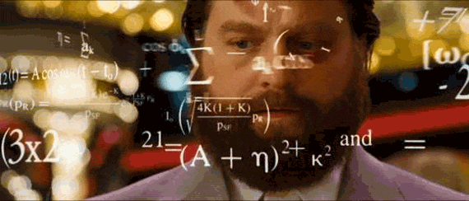
Tips for Success
Do not wait until the last minute.
Work Together (except during the test/exam):
Synthesis
Application
Evaluation
Explanation
Work Smart (effort doesn’t necessarily equal progress).
Time Management.
Know when (and how) to ask for help.

Slide 32
Tips for Success
88% of your final grade is based on two term tests and an exam.
For these tests and exams, you’ll be to write code.
You will not be able to achieve a high mark by reading the textbook and lecture note. You need to PRACTICE, PRACTICE, PRACTICE!
How can you practice writing code?
Lecture Breakout Sessions.
Labs (this of this as studying).
Practice Problems.
Writing A Lot Of Code During The Term
=
Higher Grade

Slide 33

What is this course all about?
Learn the fundamentals of programming.
Programming as a tool used in engineering.
Engineering design through programming.

Slide 34
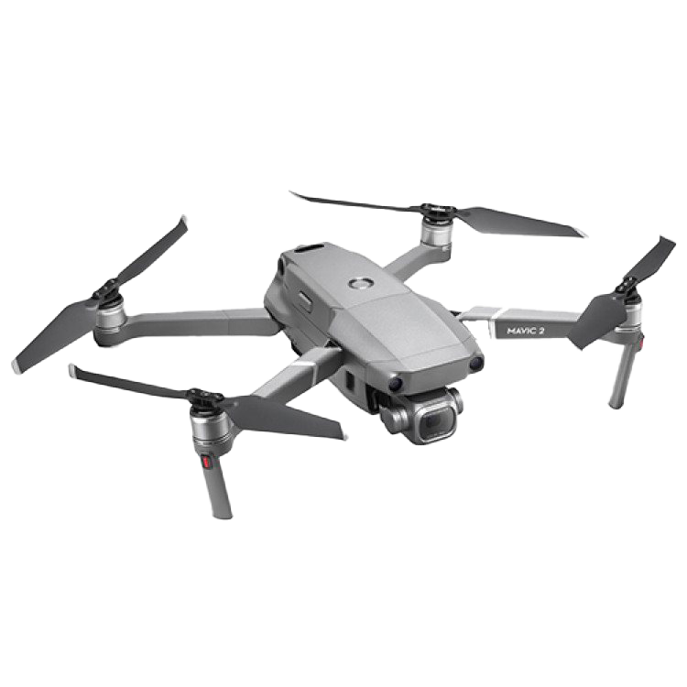

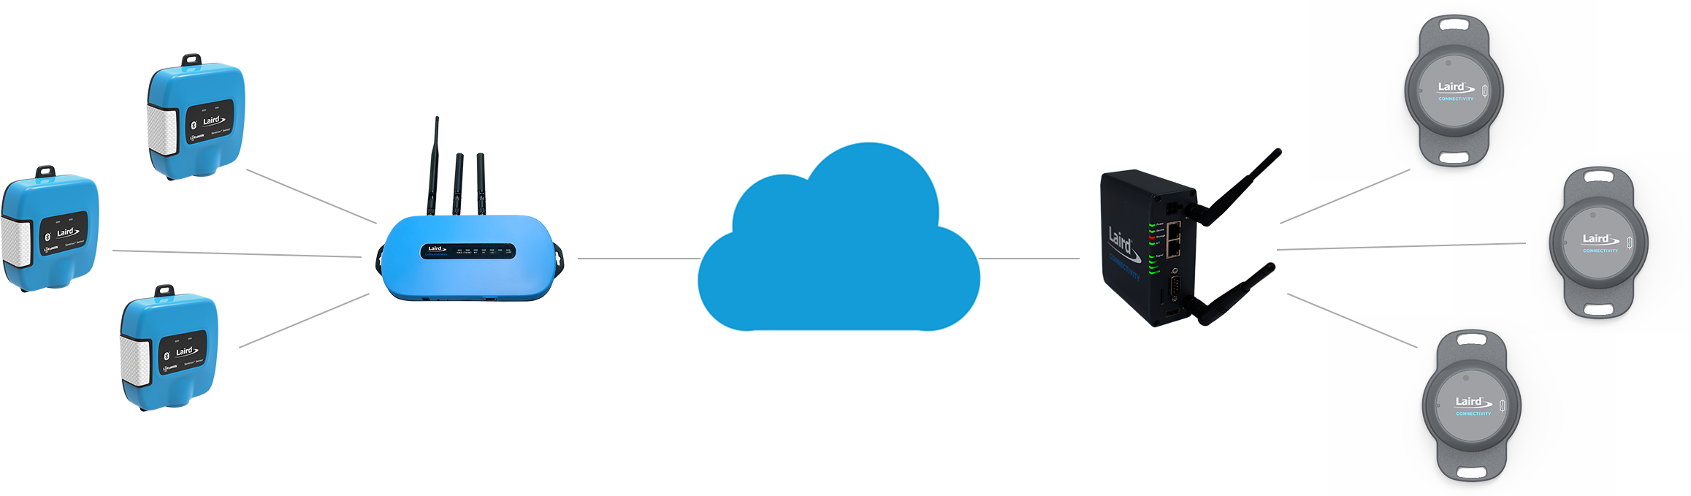

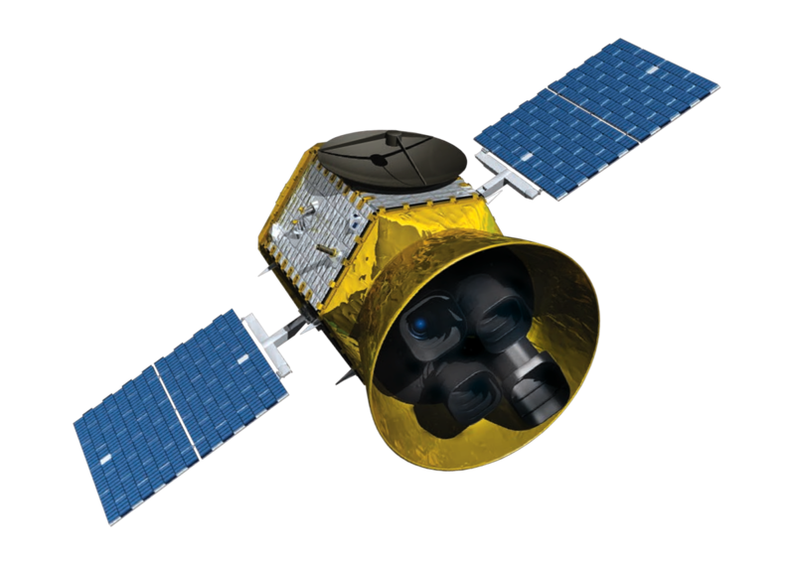
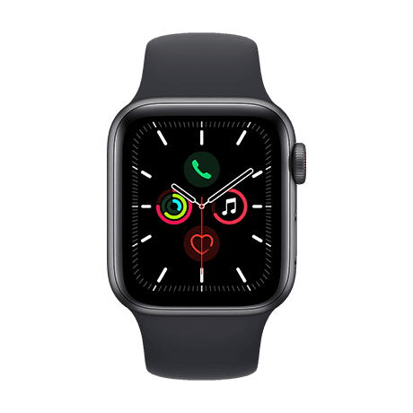
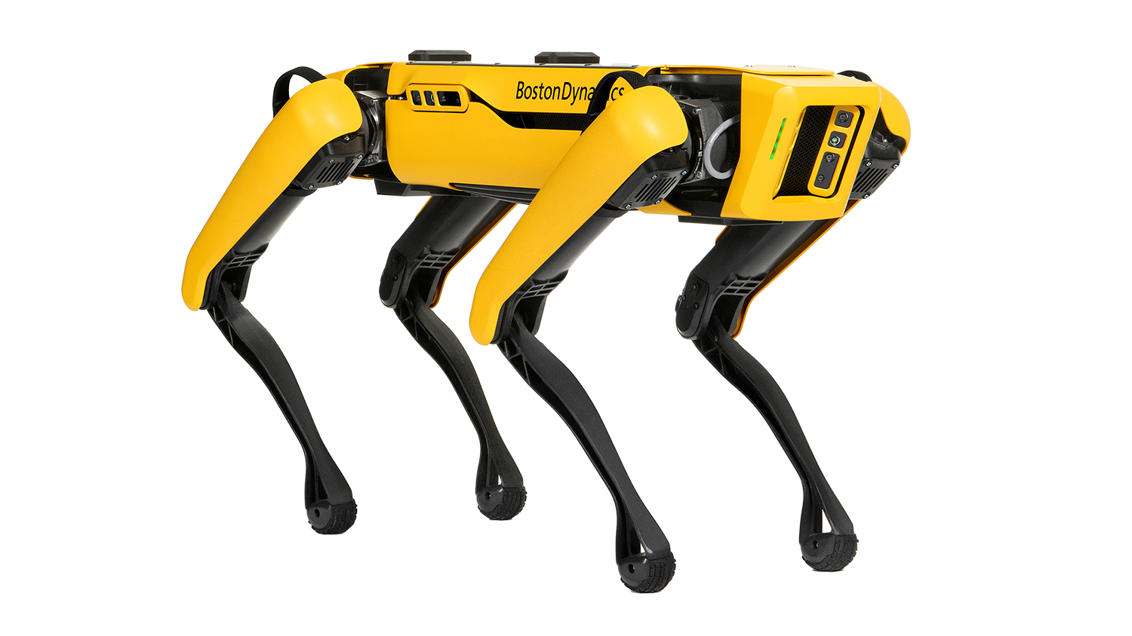
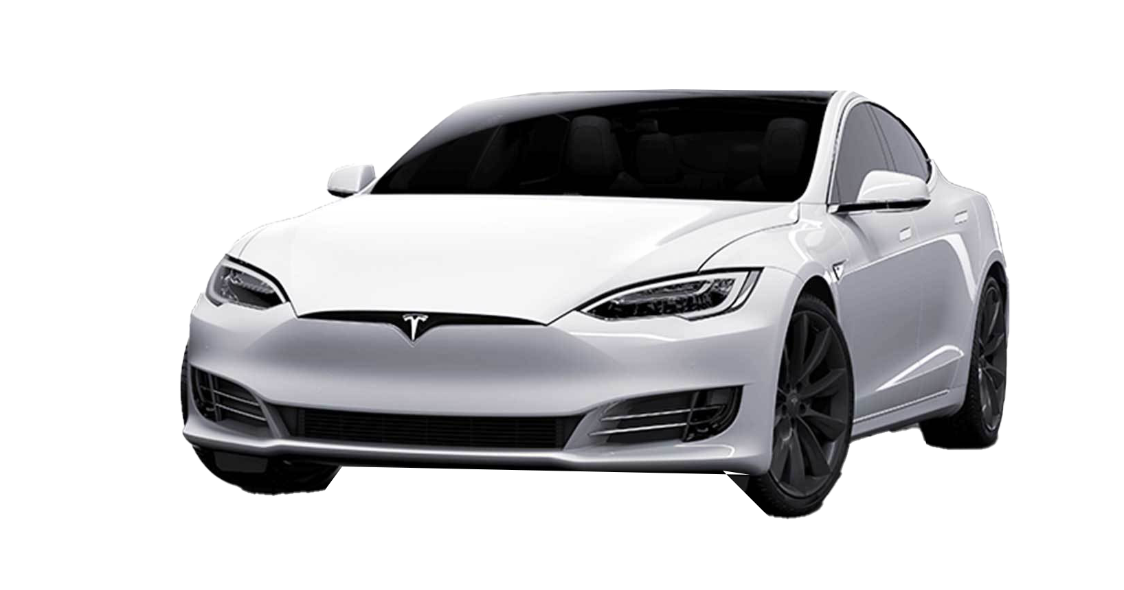
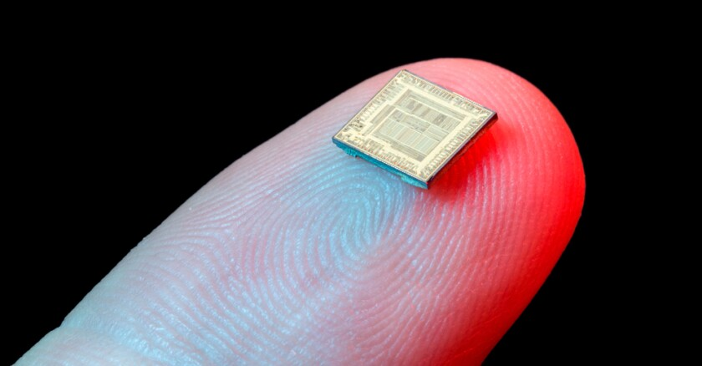
Why Programming?

Slide 35

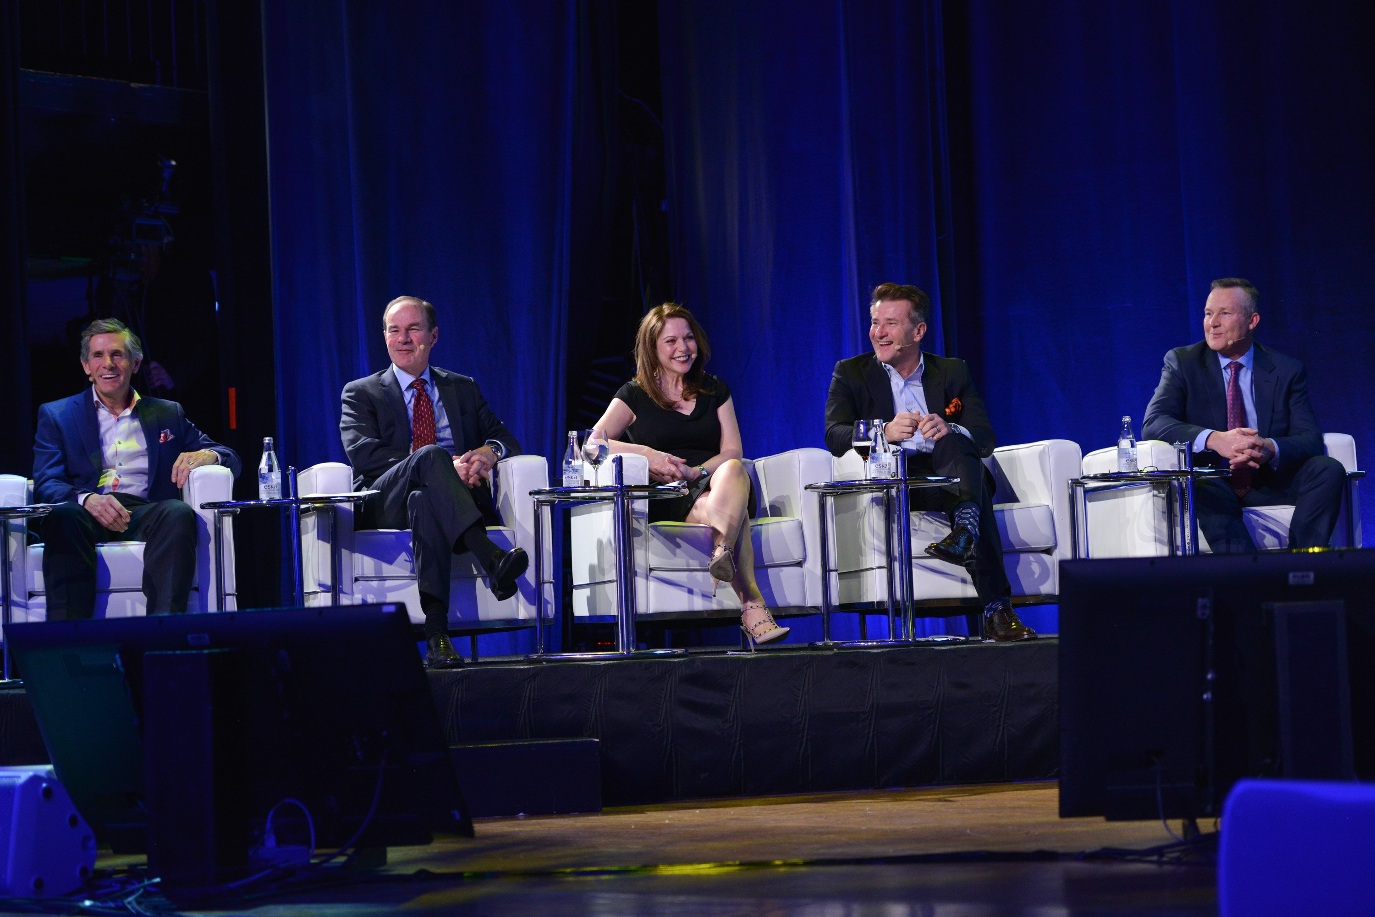
Why Programming?
Computers are everywhere:
Learn to interact with them.
Simplifies our jobs.
Entrepreneurial opportunities ($$$).
Necessary for engineering jobs.
Research and development.
Because it’s fun!
$1,000,000 Investment.
Owner of McEwen Mining Inc.
President of Cisco Systems Canada
COO of Goldcorp
CEO of Franco-Nevada Corporation
SHARK on ABC’s Shark Tank

Slide 36
What is Programming?
A way of telling a computer what to do.
A computer can’t infer (…yet).
Need to tell a computer every single step it needs to do in a language it can understand.
How would you request an egg for breakfast to a chef and to a computer/robot?
To a Chef
Sunny-side up, please!
To a Computer
“Turn on stove”
“Take out pan”
“Take one egg out of fridge”
“Crack egg”
“Pour egg into pan”
“Wait 5 minutes”

Slide 37

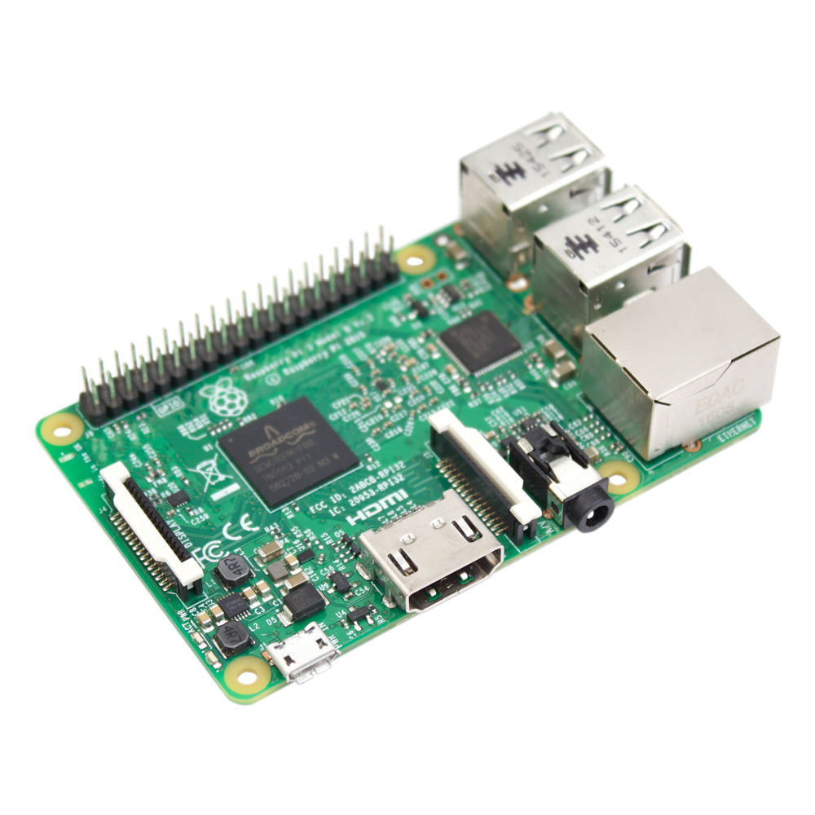
Programmer
English
How to Program a Computer.
Pseudocode
Programing Language
Compiler
Assembly Code
Assembler
Machine Code
Hardware

Slide 38
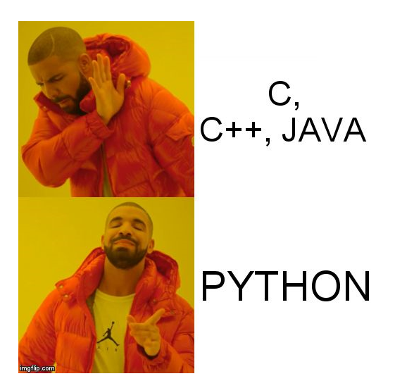
Why Python?
High-level language making it more like a readable, human language than other low-level languages.
Simple and clear syntax.
Large open-source community.
Used by Google, Firefox, Dropbox, Youtube, Instagram, Yelp, NASA, CIA, etc.
The Artificial Intelligence (AI) community overwhelmingly uses Python.

Slide 39


Why Python?
Lower-Level
High-level language making it more like a readable, human language than other low-level languages.
Simple and clear syntax.
Large open-source community.
Used by Google, Firefox, Dropbox, Youtube, Instagram, Yelp, NASA, CIA, etc.
The Artificial Intelligence (AI) community overwhelmingly uses Python.
public class HelloWorld
{
public static void main(String[ ] args)
{
system.out.println(“Hello World!”);
}
}
Higher-Level
print(“Hello World!”)

Slide 40
Why Python?
Increasing Program Size
Matlab, SQL
C++, Java, Python
High-level language making it more like a readable, human language than other low-level languages.
Simple and clear syntax.
Large open-source community.
Used by Google, Firefox, Dropbox, Youtube, Instagram, Yelp, NASA, CIA, etc.
The Artificial Intelligence (AI) community overwhelmingly uses Python.
C, Fortran, Pascal
Assembly Code
Machine Code
Hardware
Increasing
Ease-of-Use

Slide 41
Why Python?
High-level language making it more like a readable, human language than other low-level languages.
Simple and clear syntax.
Large open-source community.
Used by Google, Firefox, Dropbox, Youtube, Instagram, Yelp, NASA, CIA, etc.
The Artificial Intelligence (AI) community overwhelmingly uses Python.
if x > 10:
print(“x is greater than 10”)
You don’t know Python.
Can you figure out what this code does?

Slide 42
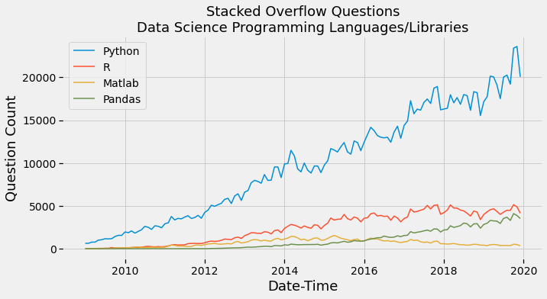
Why Python?
High-level language making it more like a readable, human language than other low-level languages.
Simple and clear syntax.
Large open-source community.
Used by Google, Firefox, Dropbox, Youtube, Instagram, Yelp, NASA, CIA, etc.
The Artificial Intelligence (AI) community overwhelmingly uses Python.

Slide 43









Why Python?
High-level language making it more like a readable, human language than other low-level languages.
Simple and clear syntax.
Large open-source community.
Used by Google, Firefox, Dropbox, Youtube, Instagram, Yelp, NASA, CIA, etc.
The Artificial Intelligence (AI) community overwhelmingly uses Python.

Slide 44









Why Python?
High-level language making it more like a readable, human language than other low-level languages.
Simple and clear syntax.
Large open-source community.
Used by Google, Firefox, Dropbox, Youtube, Instagram, Yelp, NASA, CIA, etc.
The Artificial Intelligence (AI) community overwhelmingly uses Python.

Slide 45
Why Python?
High-level language making it more like a readable, human language than other low-level languages.
Simple and clear syntax.
Large open-source community.
Used by Google, Firefox, Dropbox, Youtube, Instagram, Yelp, NASA, CIA, etc.
The Artificial Intelligence (AI) community overwhelmingly uses Python.

Slide 46

Why Engineers?
Ok, so we’ve explained why coding is important and why we’re learning to code in Python.
BUT, you’re all engineers, right?
Mechanical
Materials
Civil
Chemical
Mineral
Why do these kinds of engineers need to know how to code?

Slide 47
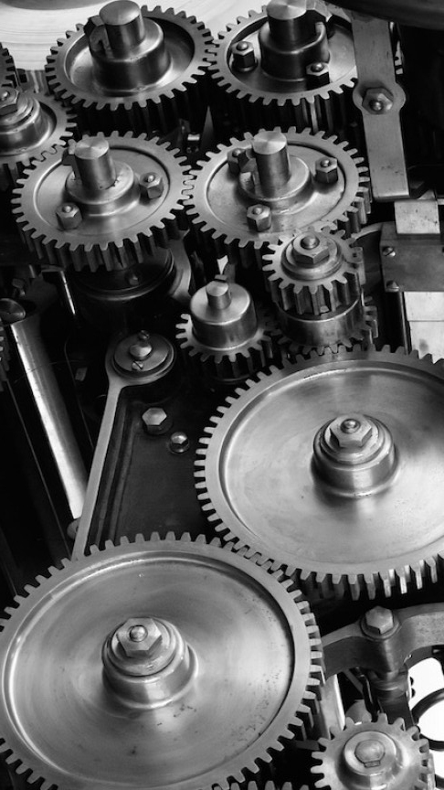
Mechanical Engineers
Design Airplanes
Micro Fluid Systems
Automotive Engines
Hydraulic Dams

Slide 48
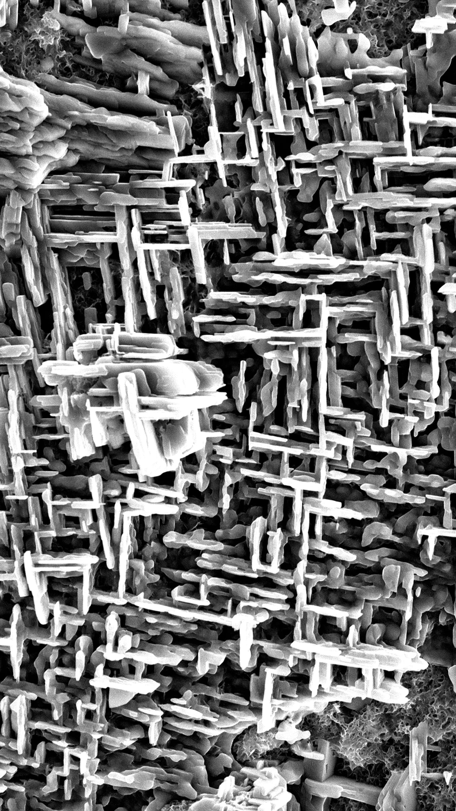
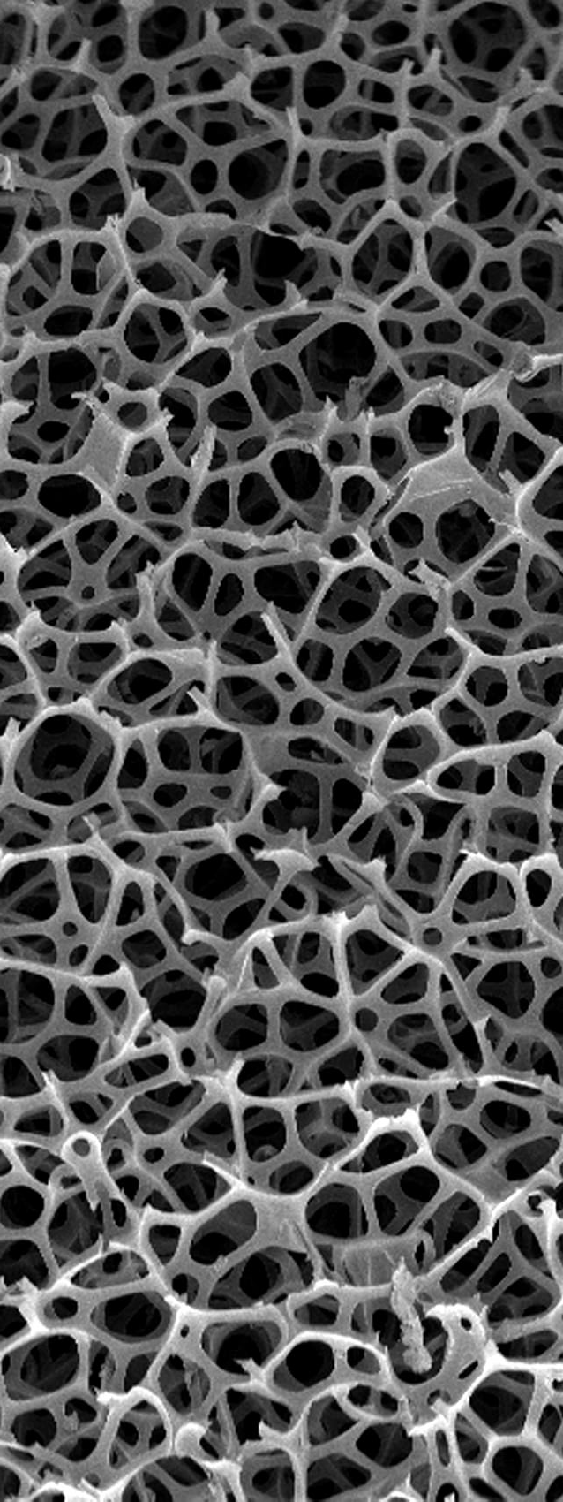
Materials Engineers
Biomaterials
Design of Materials
Manufacturing with Materials
Sustainable Materials Processing

Slide 49

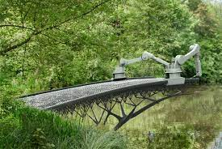
Civil Engineers
Design Buildings
Test Concrete
Manage Water Supply System
Design Bridges

Slide 50

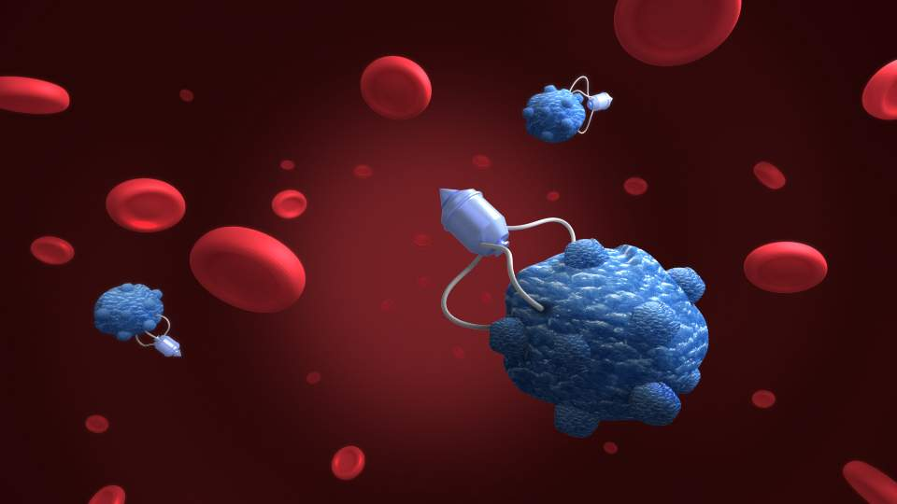
Chemical Engineers
Chemical Manufacturing Processes
Petroleum Extraction
Nanotechnology
Manufacturing Computer Components

Slide 51
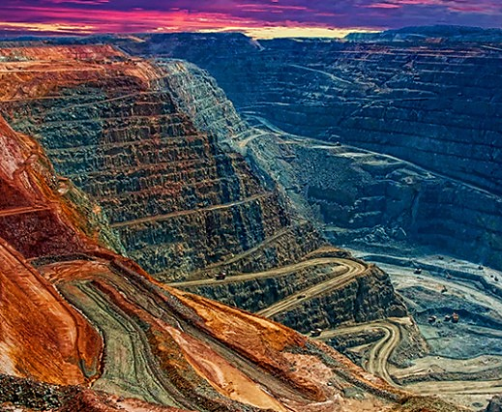
Mineral Engineers
Mine Design
Mineral Processing
Mineral Exploration
Mining Finance
Mineral Extraction

Slide 52
Why Engineers?
Again, why do engineers need to know how to code?
In the 20th century, engineers didn’t need to know how to code.
In the 21th century, coding is an essential skill and any engineer without solid coding abilities will be at a major disadvantage.

Slide 53
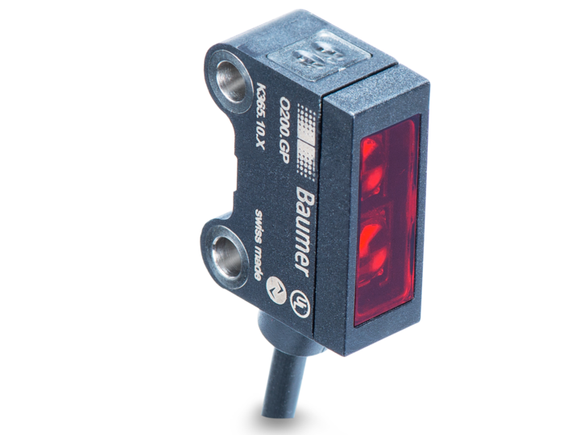




Why Engineers?
Five technology trends have changed the game for engineers.
The Cloud
Cheap Sensors
Artificial
Intelligence
Big Data
The Internet
Of Things

Slide 54
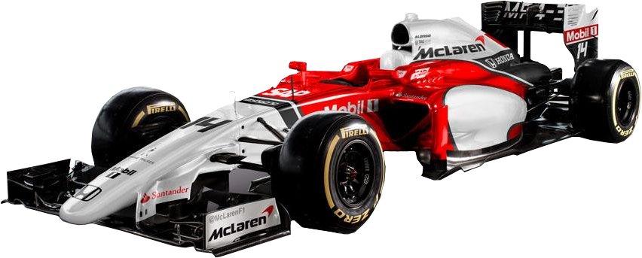
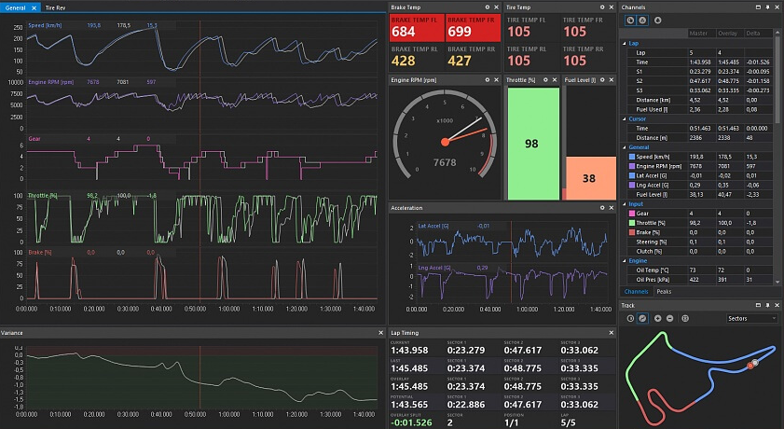
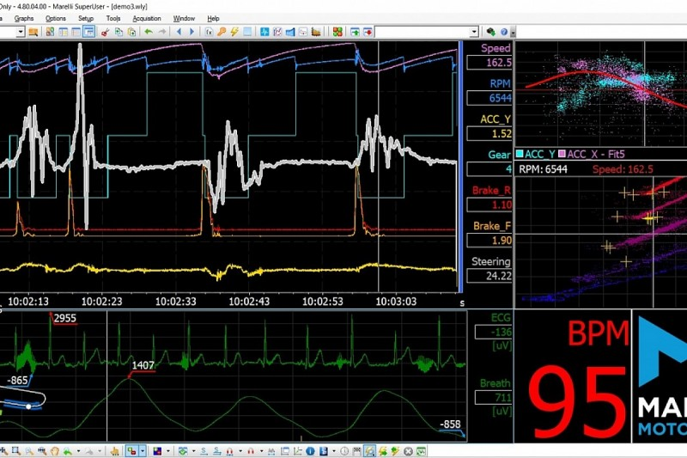

Mechanical Engineers
Realtime Diagnostics & Tuning

Slide 55
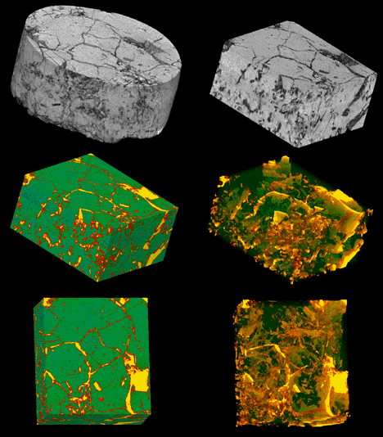
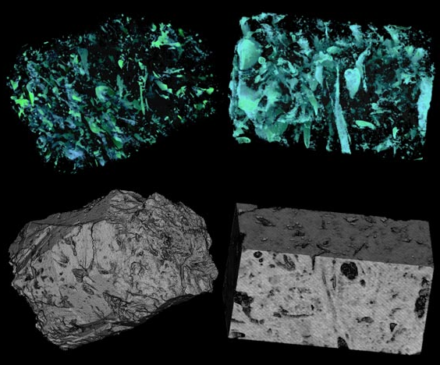
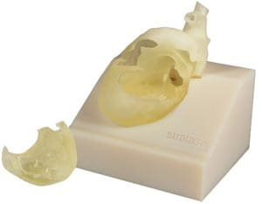
Materials Engineers
Digital Image Analysis of Material Microstructure

Slide 56
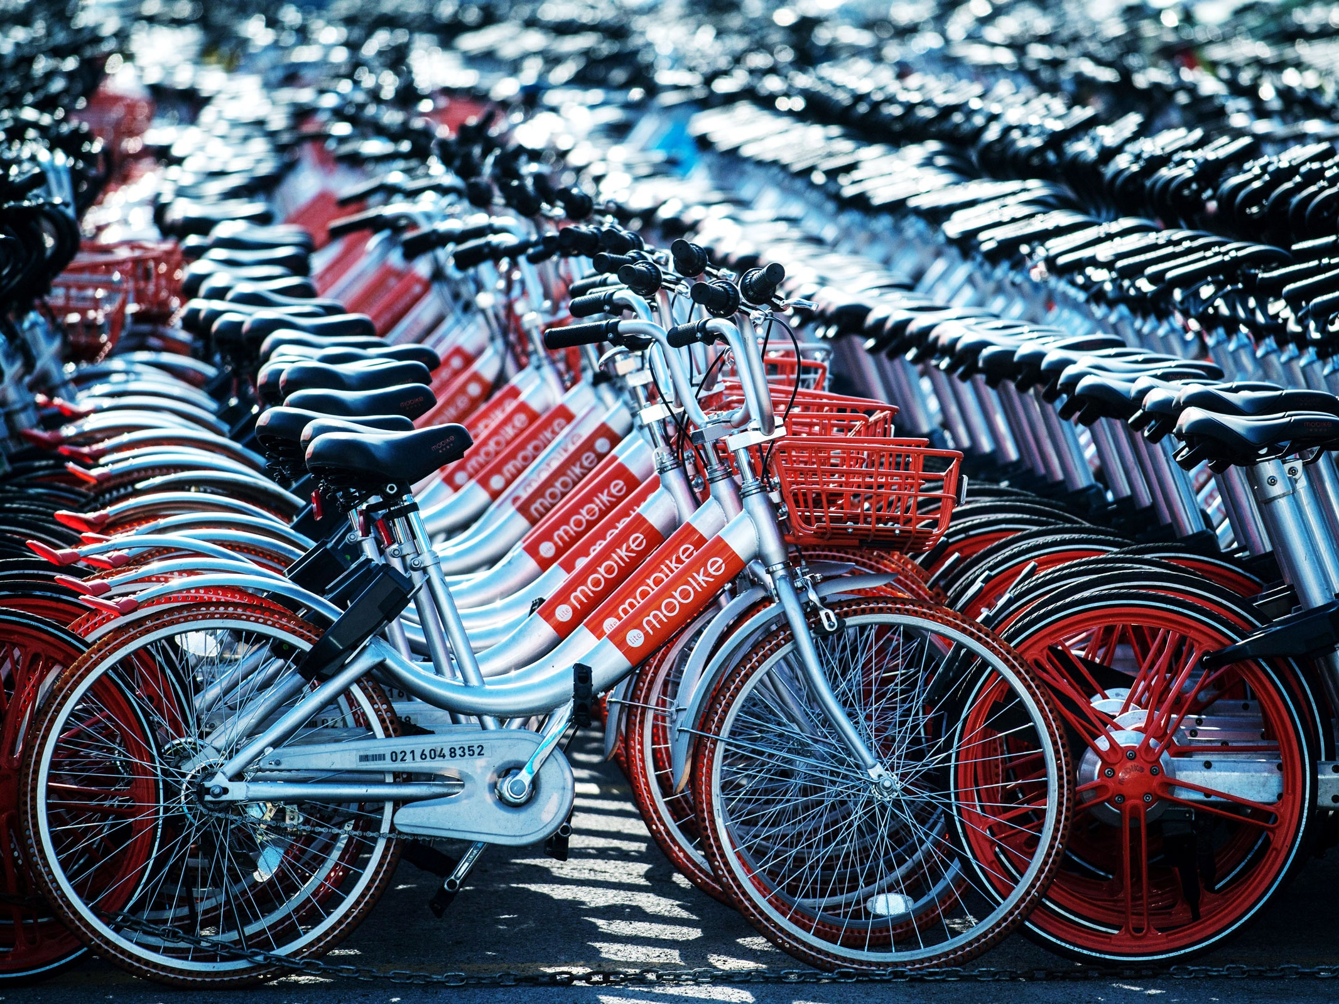

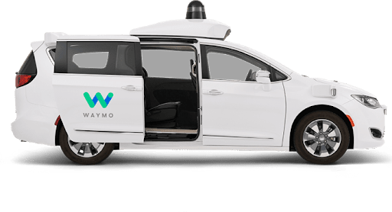
Civil Engineers
Urban Transportation Disrupted

Slide 57
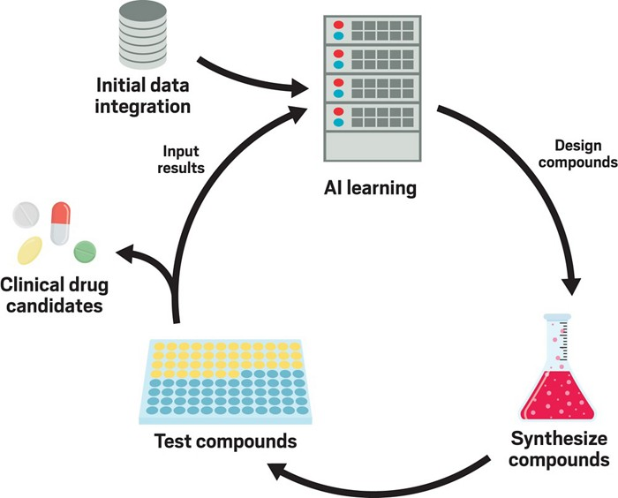
Chemical Engineers
Synthesizing new compounds

Slide 58

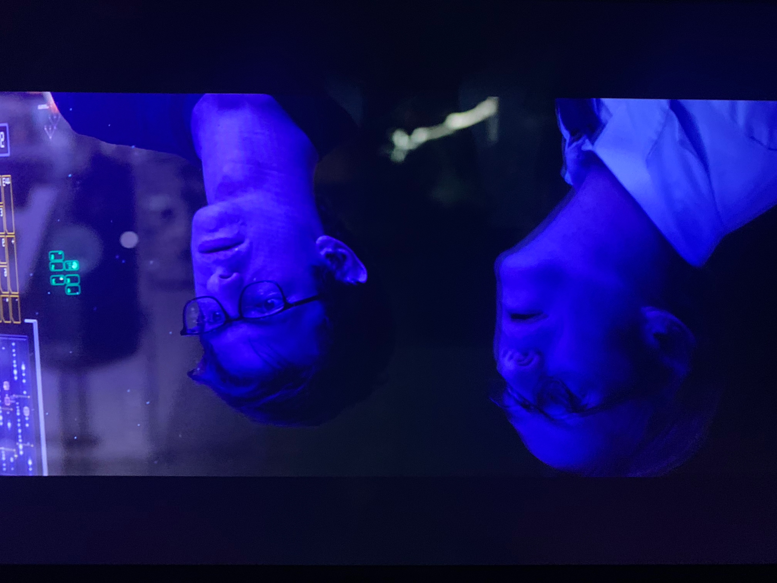
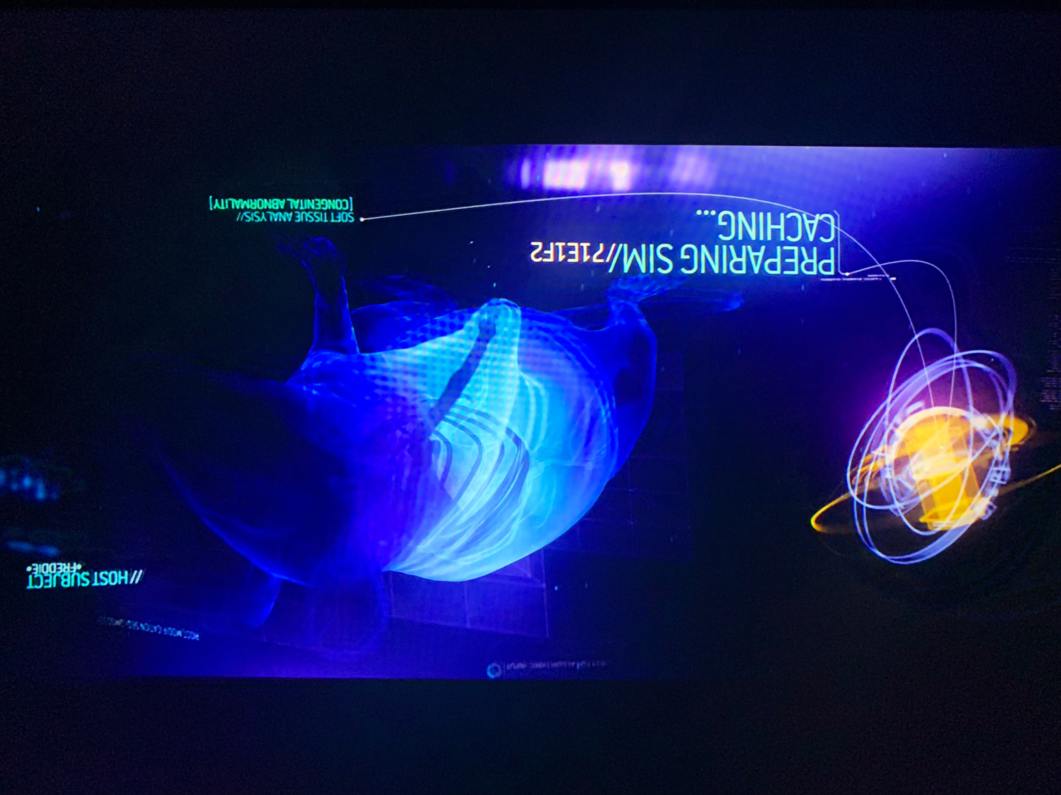
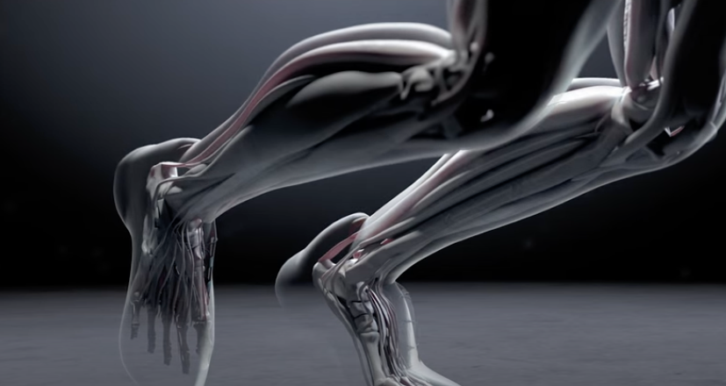
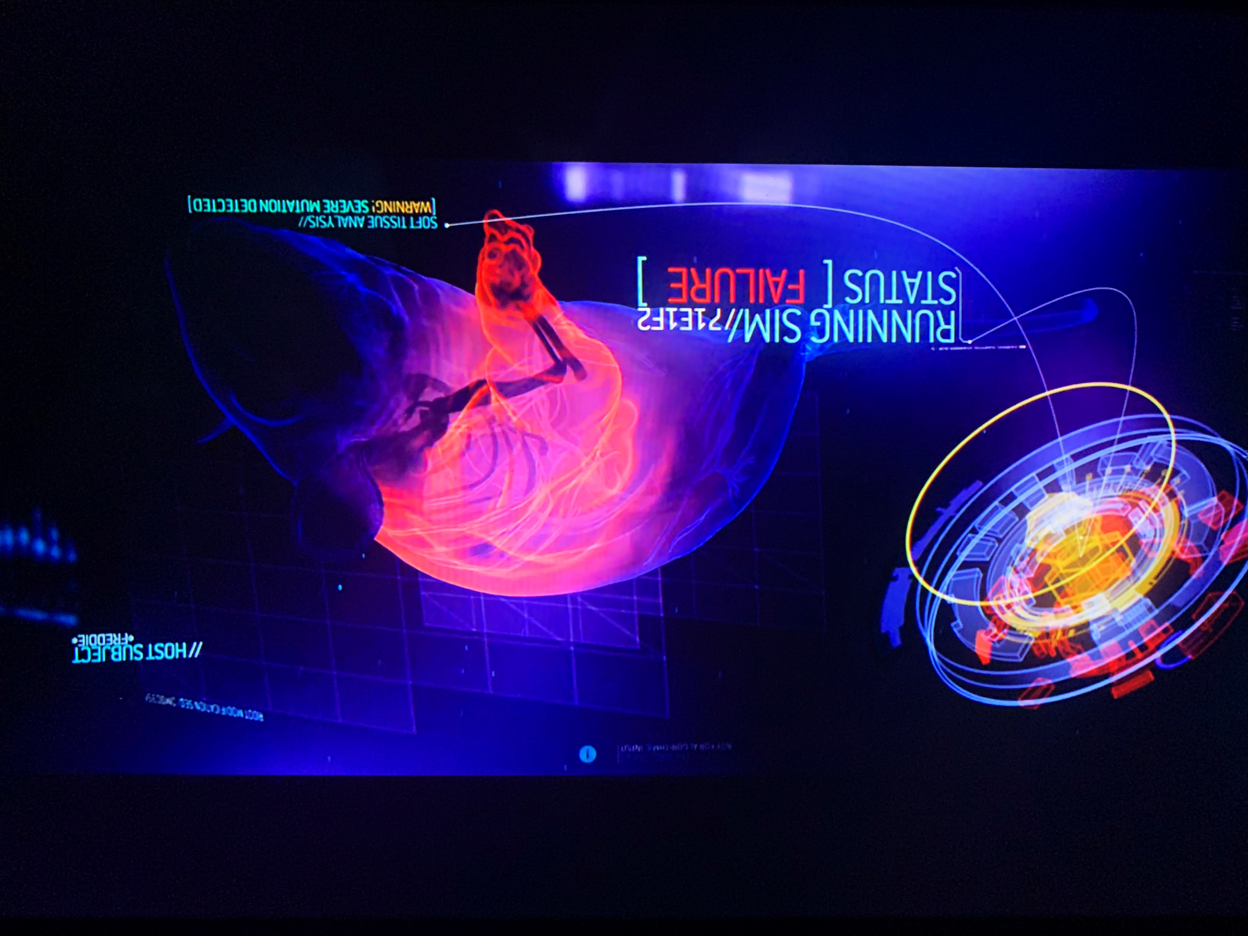


Sci-fi Inspiration

Slide 59



Mineral Engineers
Semi-Autonomous Mines

Slide 60
Programming Skills Are In Demand
According to the Developer Survey by StackOverflow, Python was one of the most in-demand technologies of 2018, 2019, 2020, and 2021.
As of 2021, it is ranked as the world’s 2nd most popular programming language among professional software developers as well as the first most wanted programming language.

Slide 61

Python Skills Are In Demand
According to the TIOBE Index, Python overtook C and Java in 2022 as the world’s most popular programming language
Notes:
Programming skills are in demand, and Python is one of the sought after and used languages in the world.

Slide 62

One of the reasons for choosing Engineering!
Finally! A course that isn’t Chem, Bio, Physics, or Math
This (as well as your engineering design course) is what separates you from many other sciences
And makes you MUCH more valuable….

Slide 63
introduction.
Week 1 | Lecture 1 (1.1)

